Slide 1
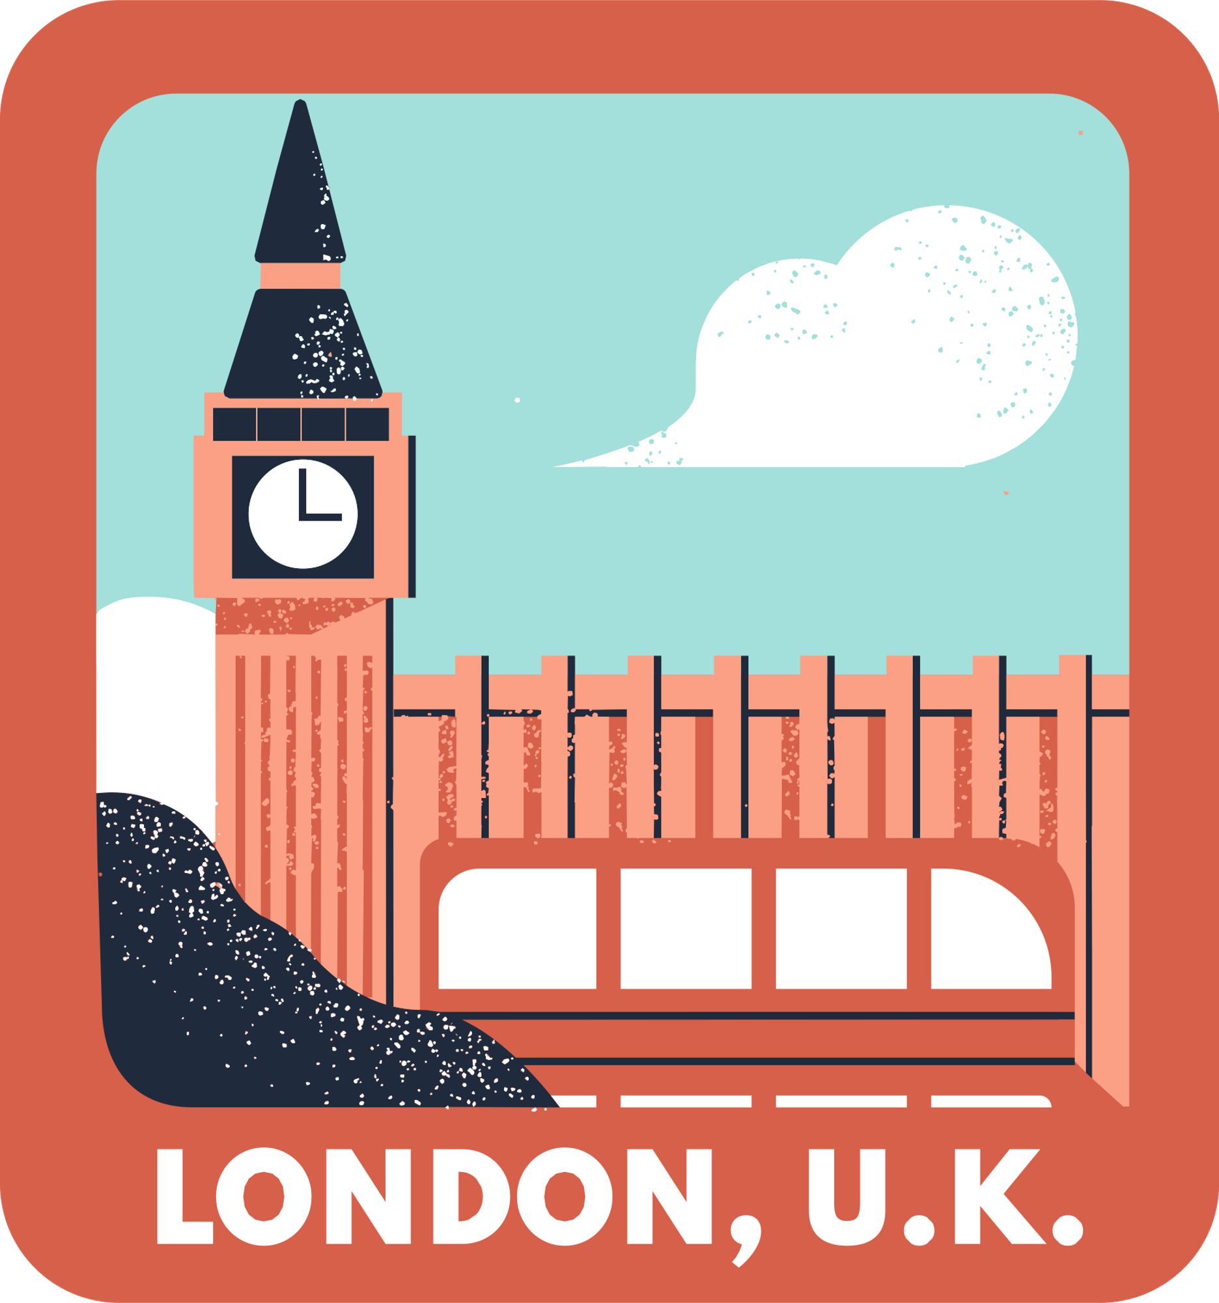
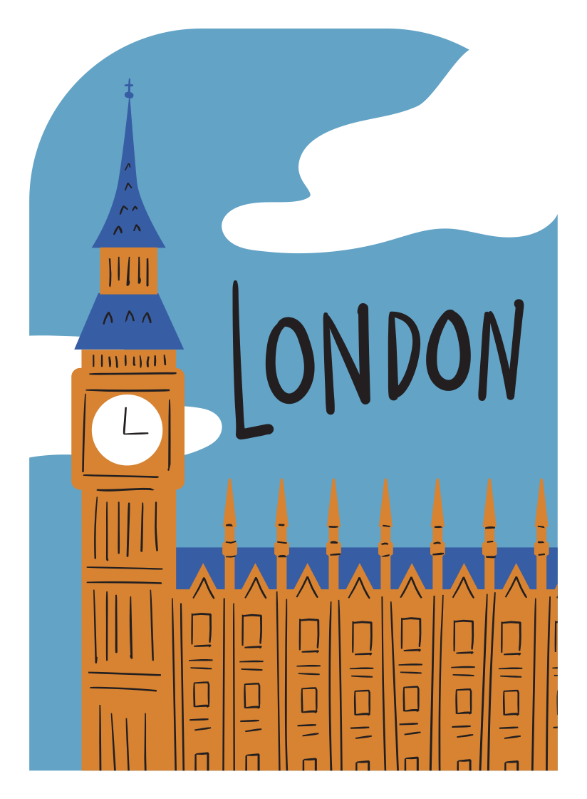


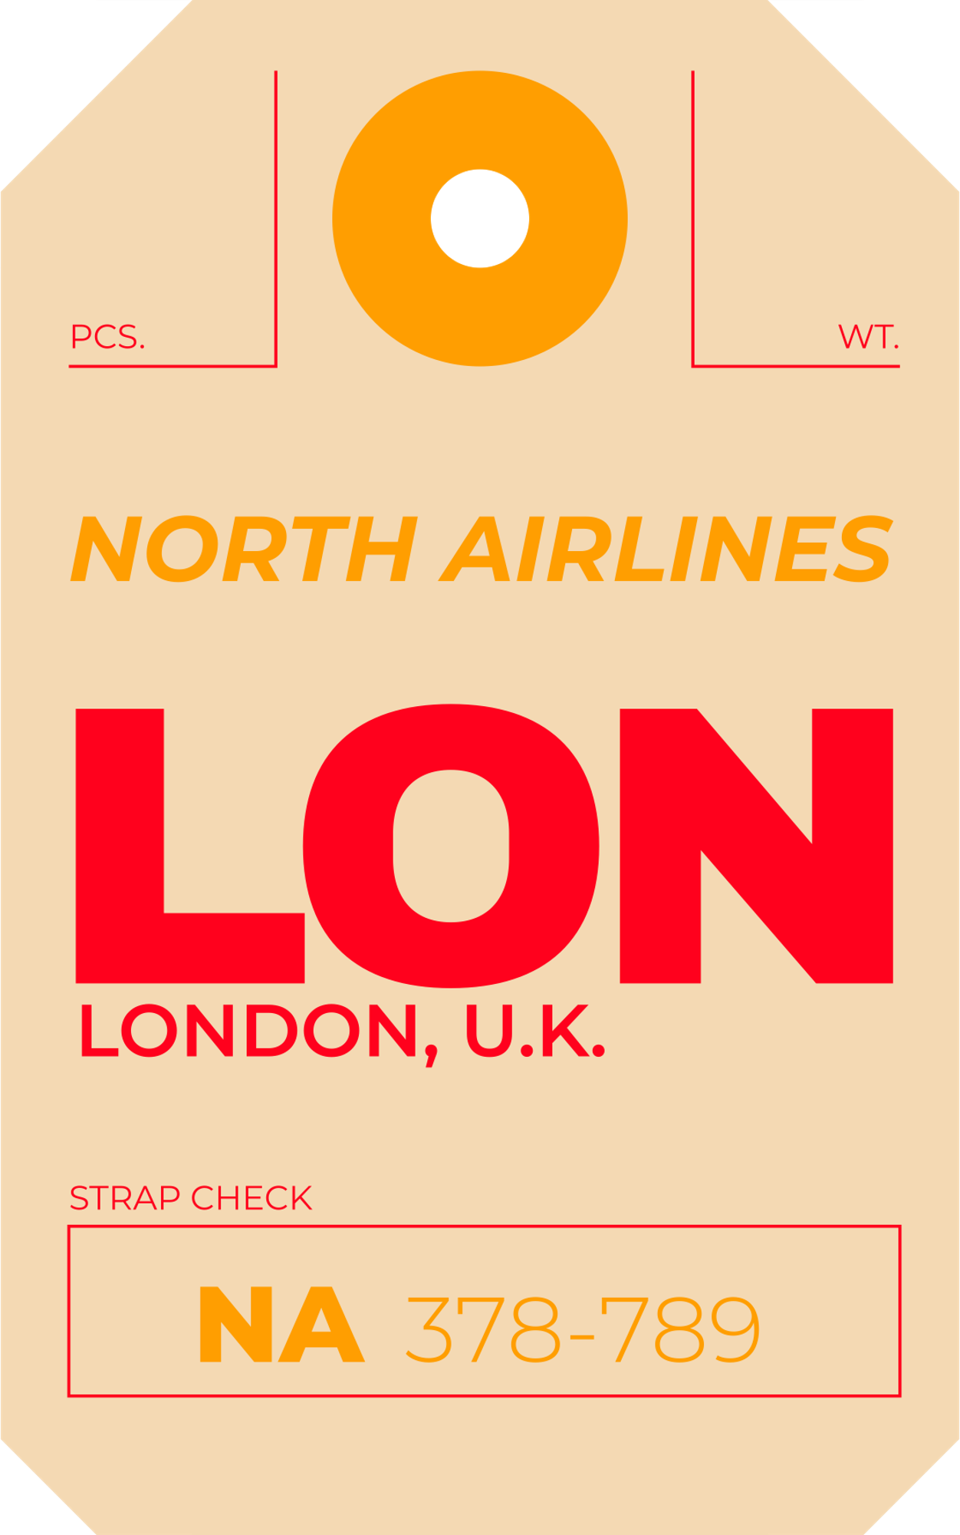
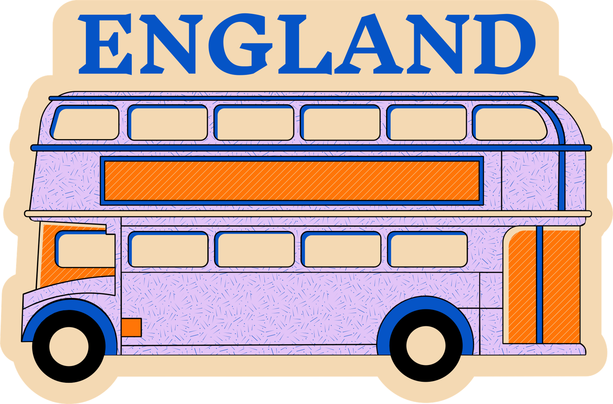
EXPLORE
LONDON
By: Anitta

Slide 2
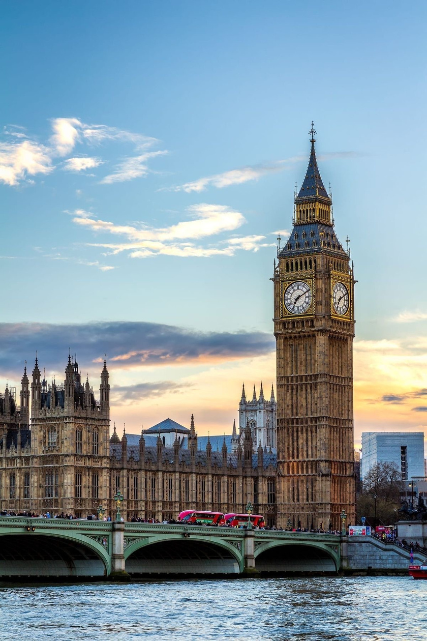

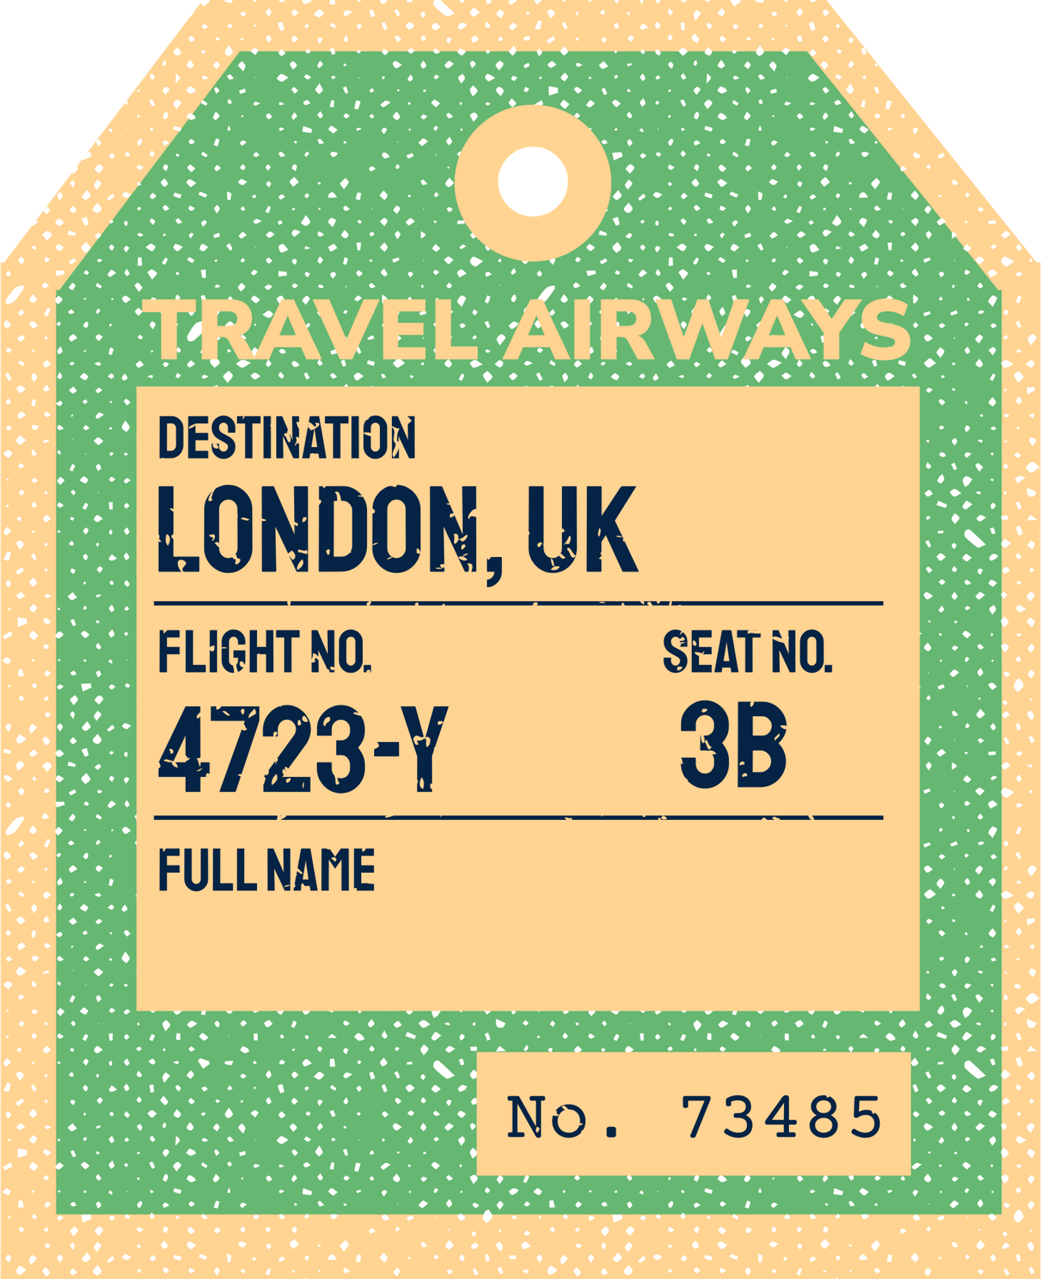
London is the capital city of the United Kingdom (UK). It is one of the most famous and important cities in the world, known for its history, culture, architecture, and economy.
¿WHAT IS LONDON?

Slide 3
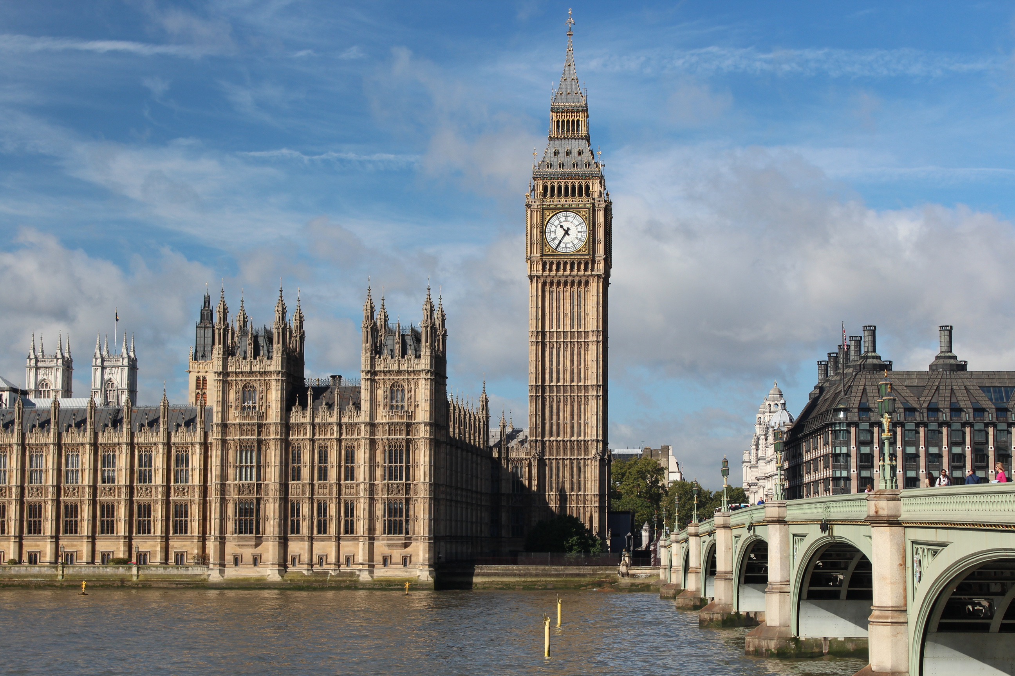

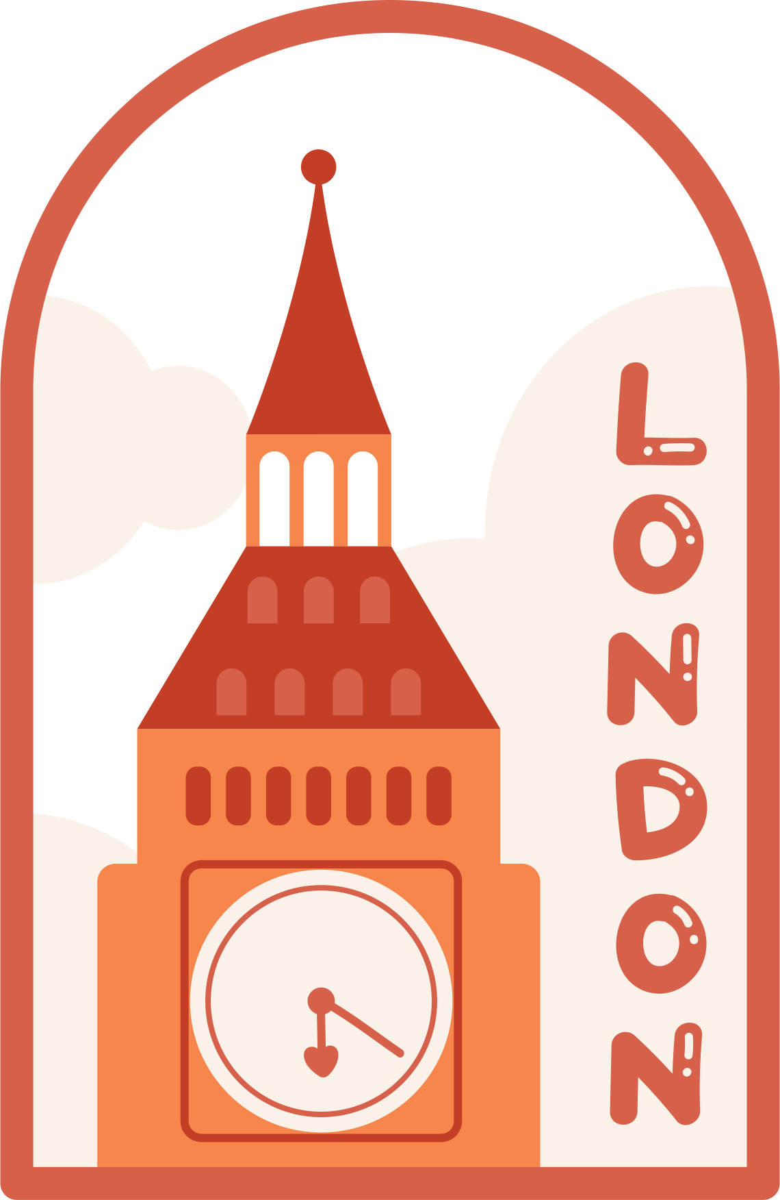
HELLO LONDON!
Big Ben and the Houses of Parliament
London Eye (giant Ferris wheel)
Tower Bridge and the Tower of London
Buckingham Palace (home of the British monarch)
British Museum, Tate Modern, and many other museums and galleries

Slide 4
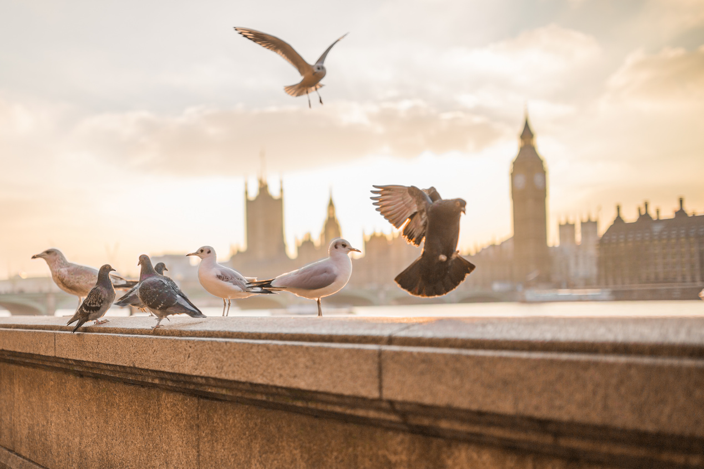
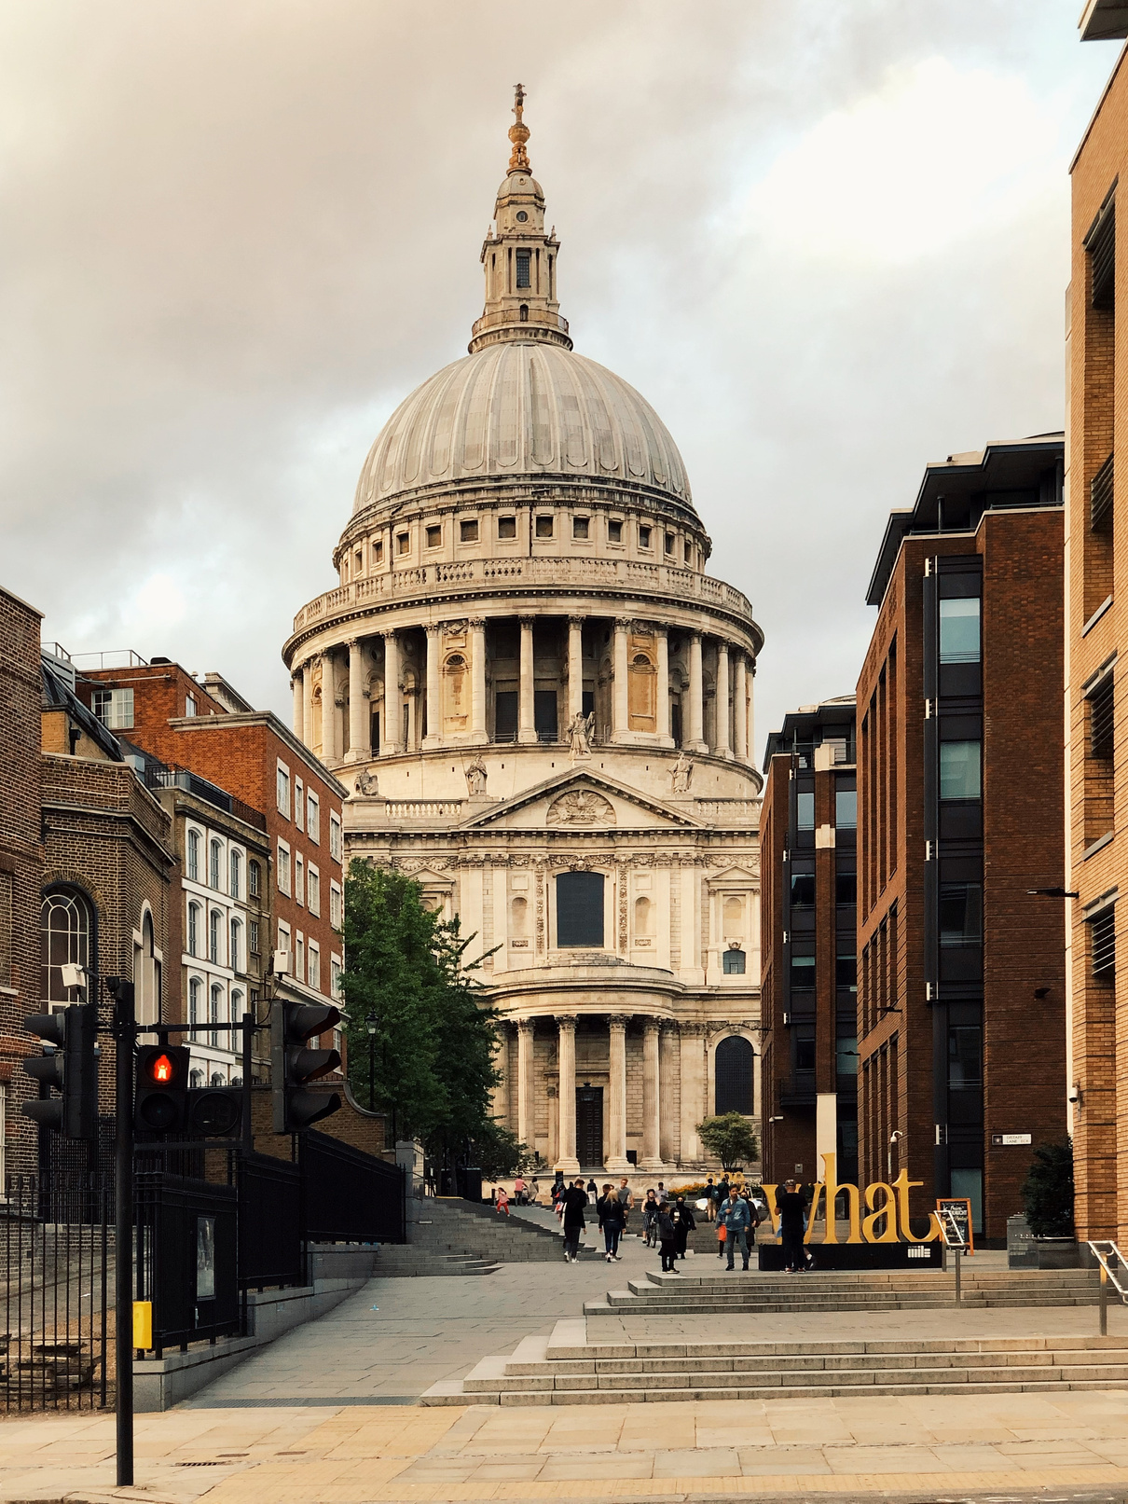

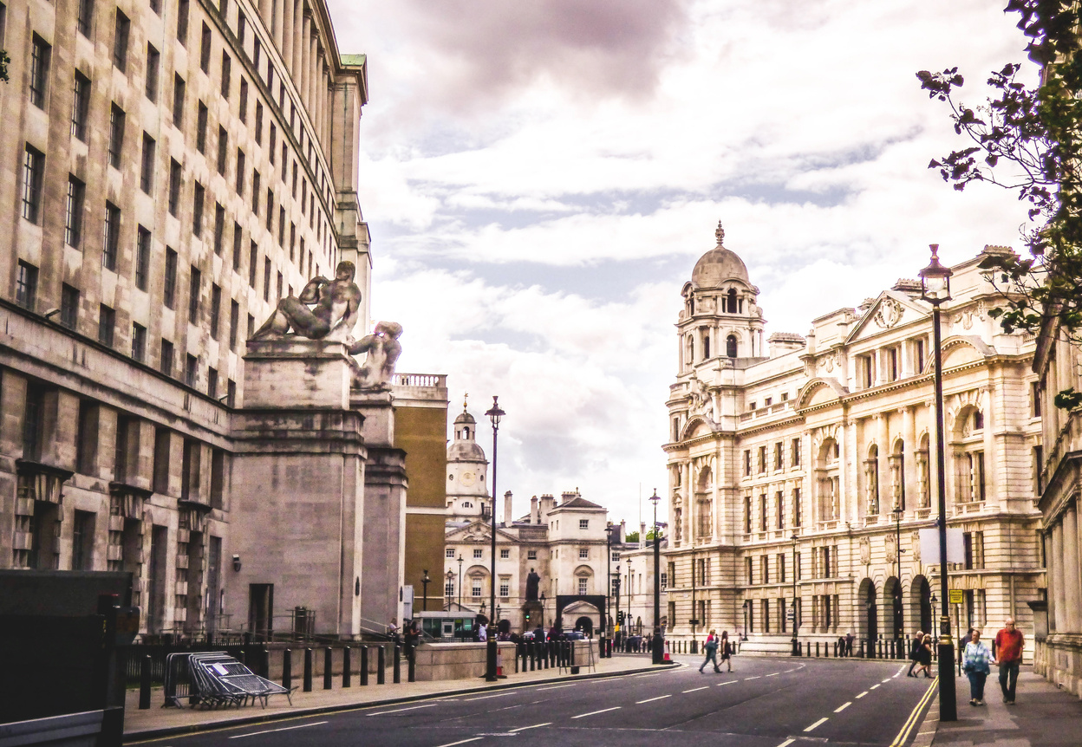
POPULATION
Over 9 million peopleI it is the largest city in the UK and one of the most diverse cities in the world.

Slide 5
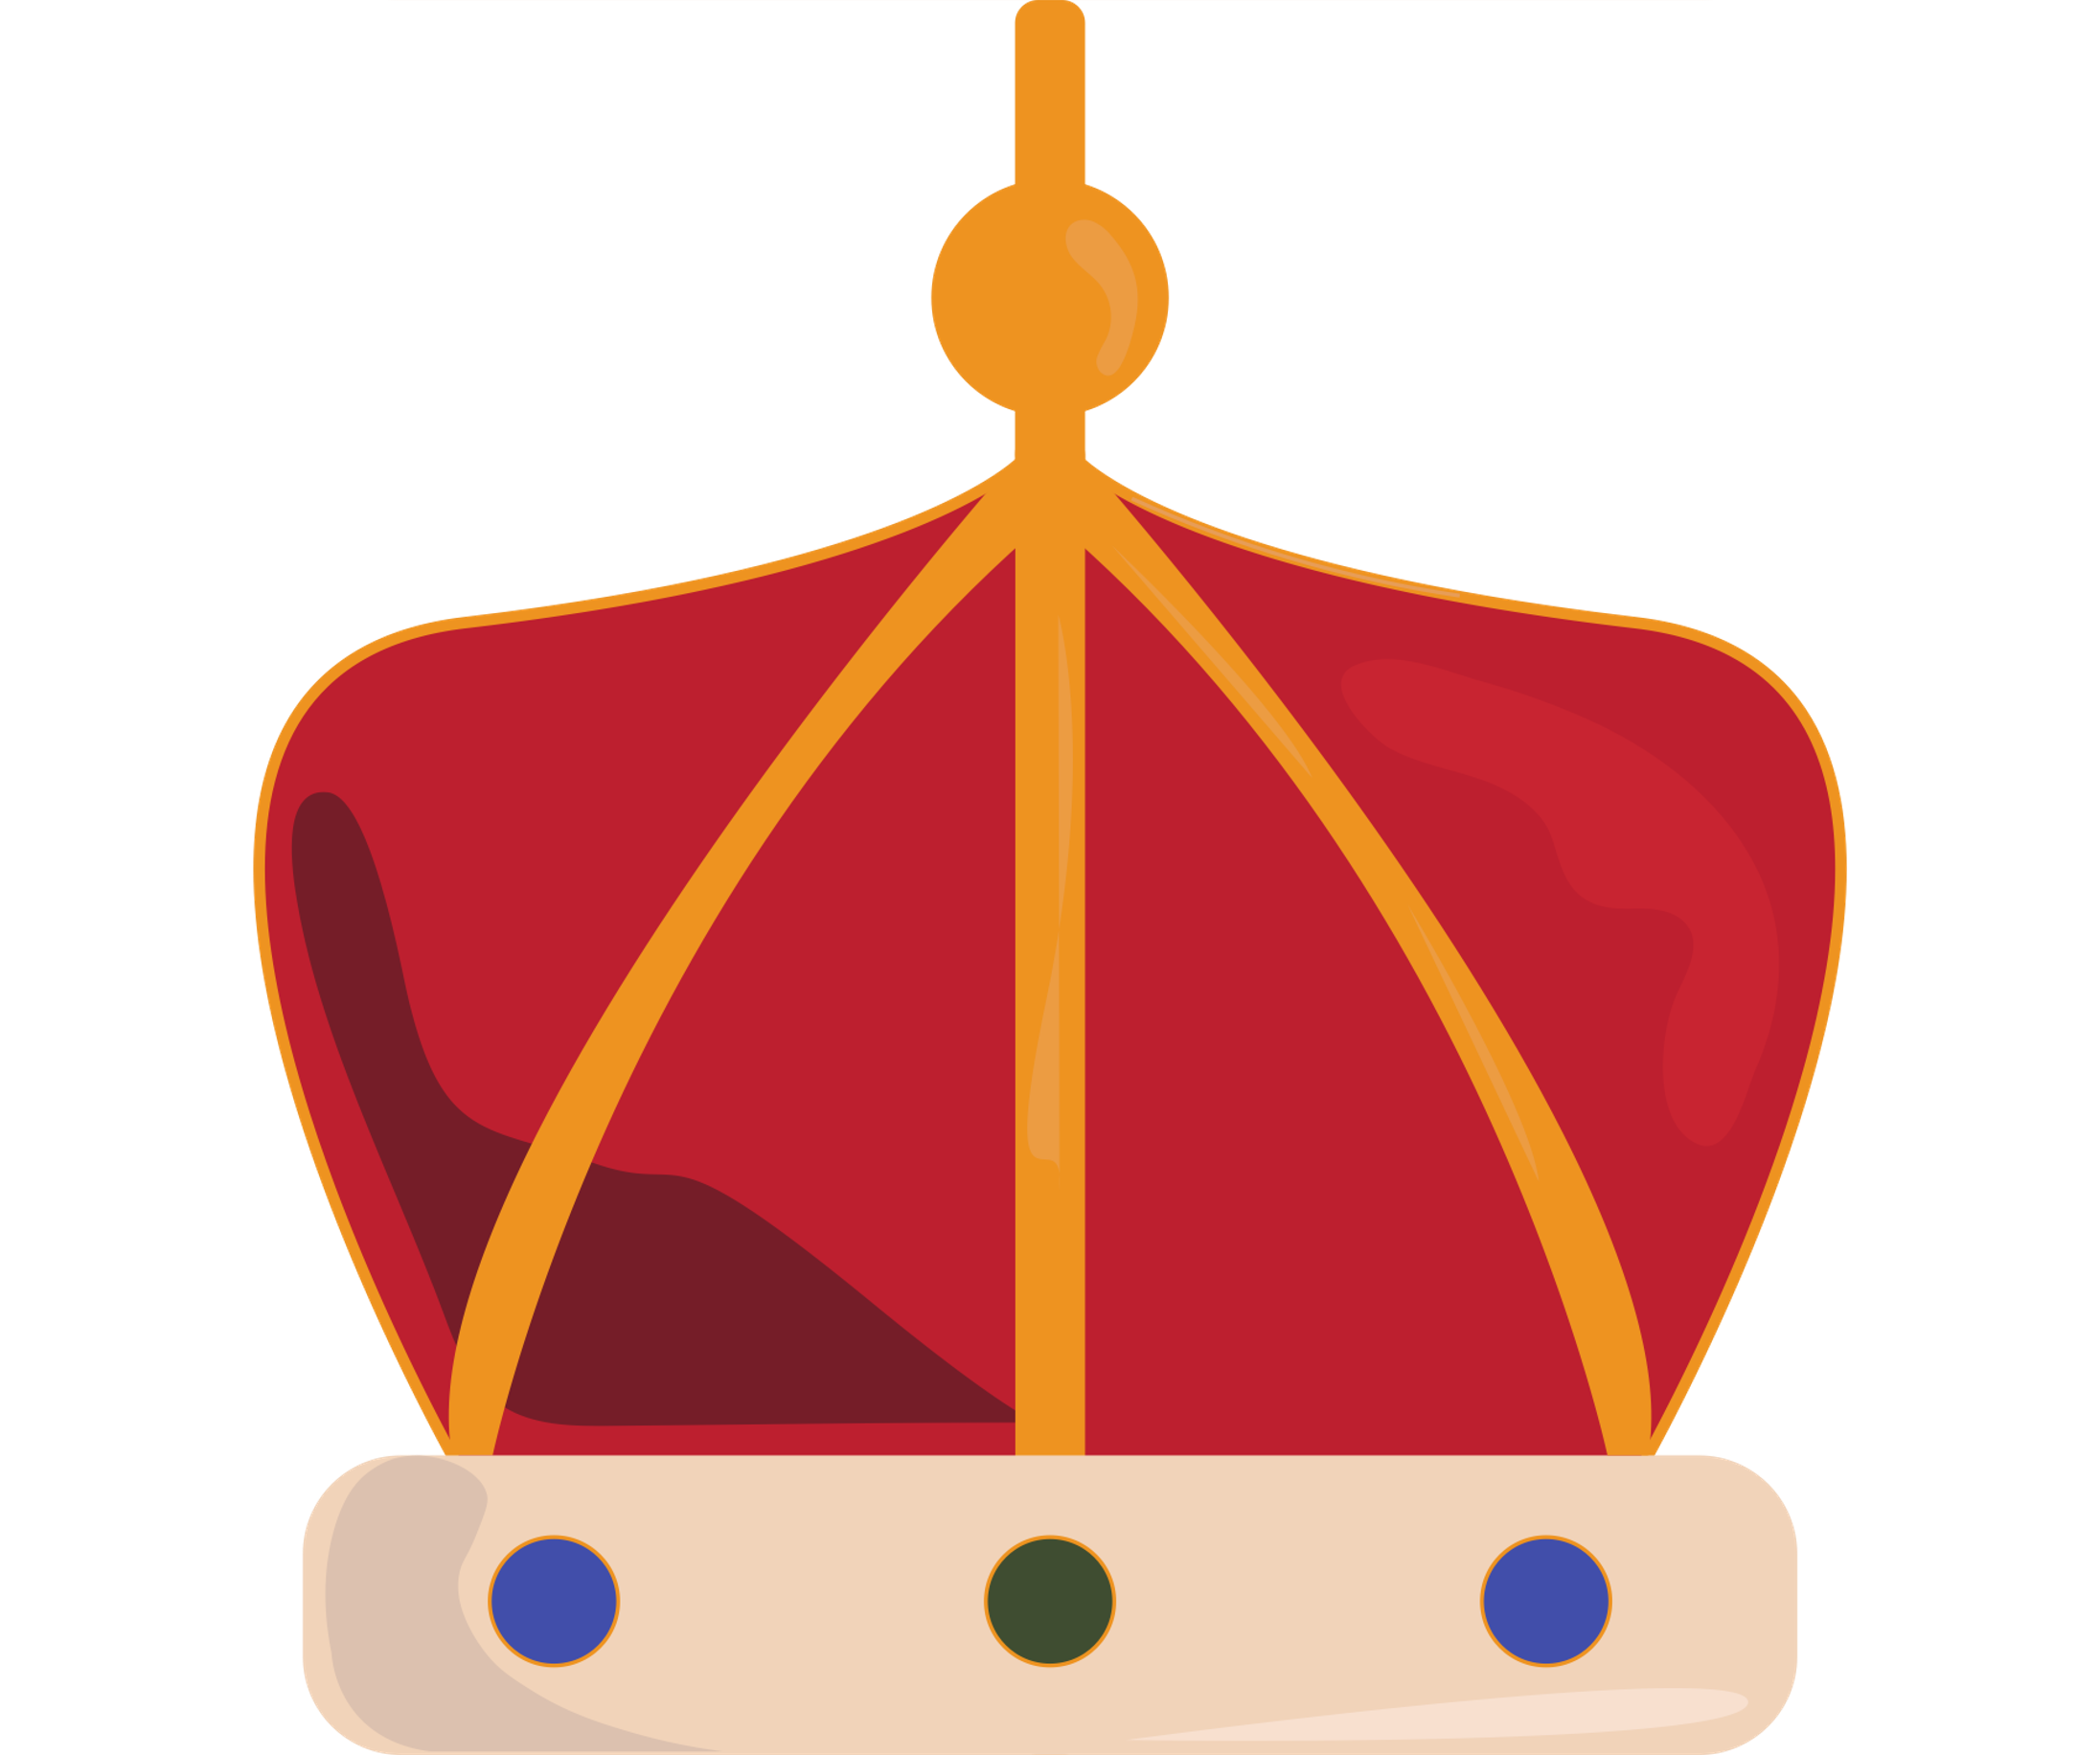
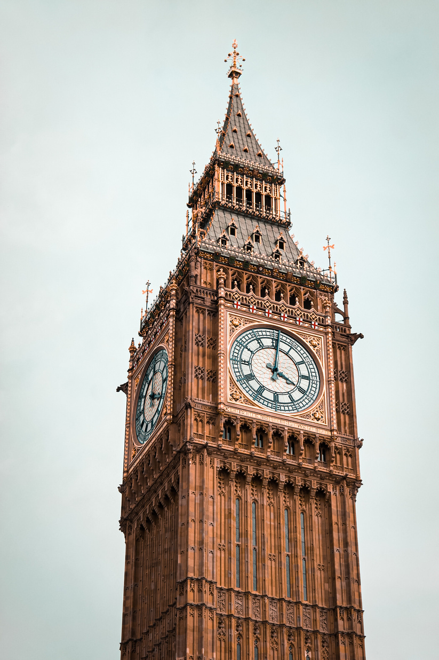
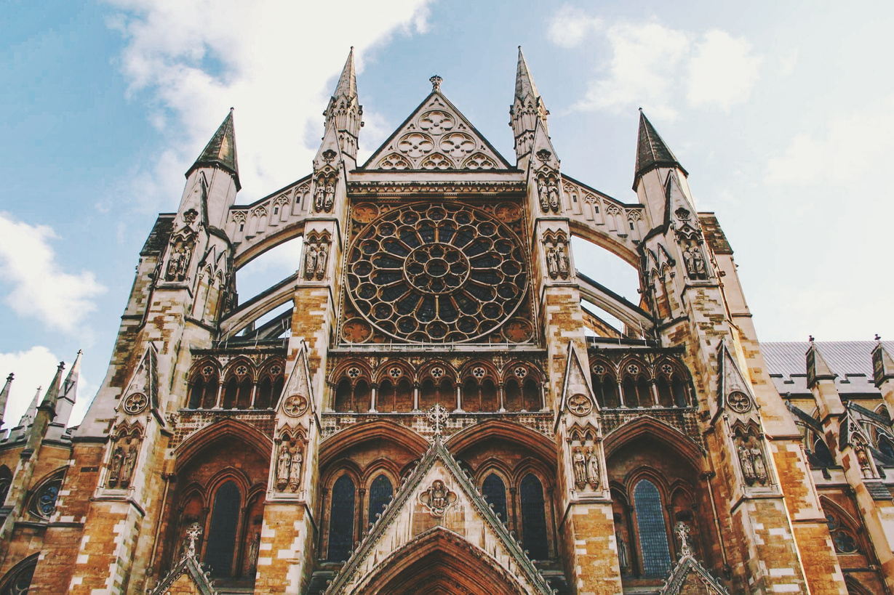
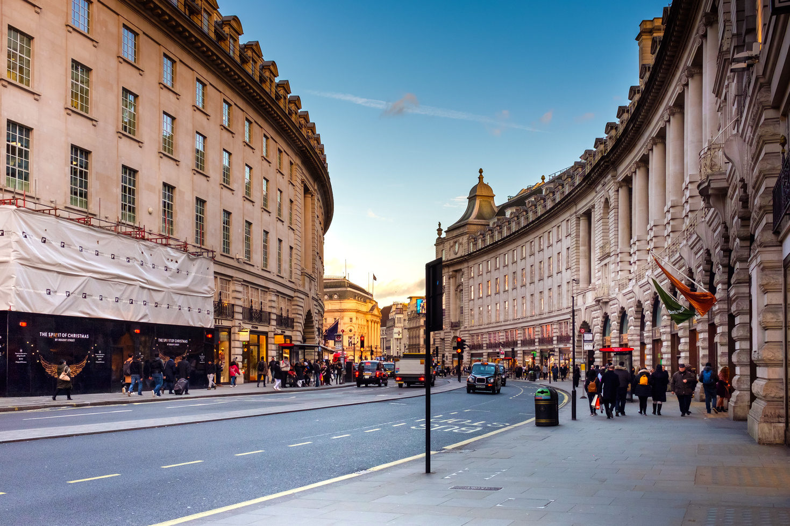

A BEAUTIFUL PLACE

Slide 6
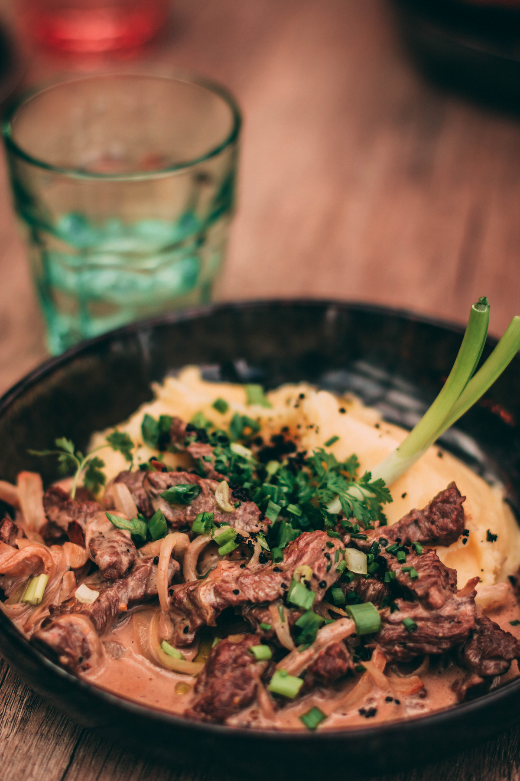
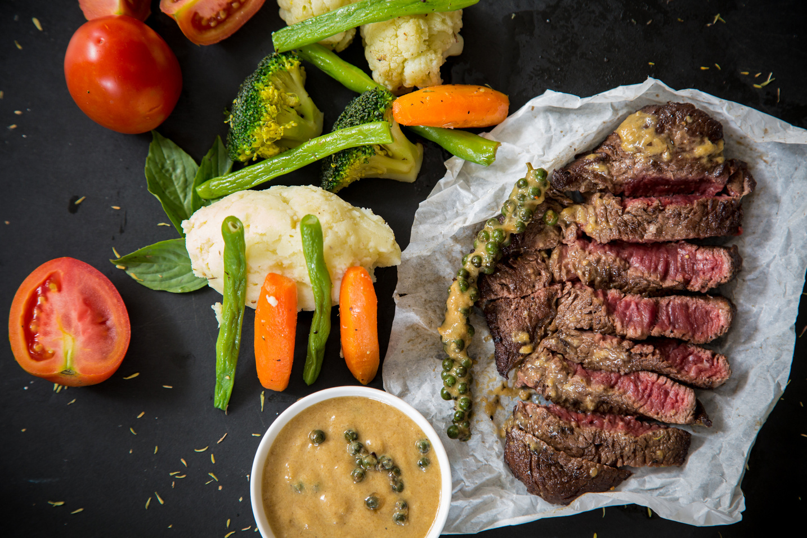

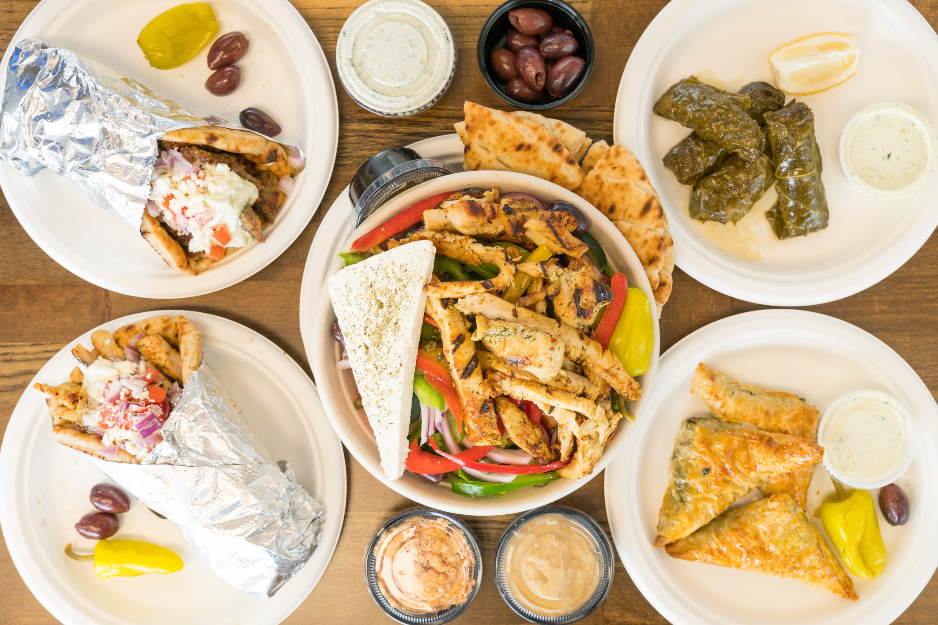
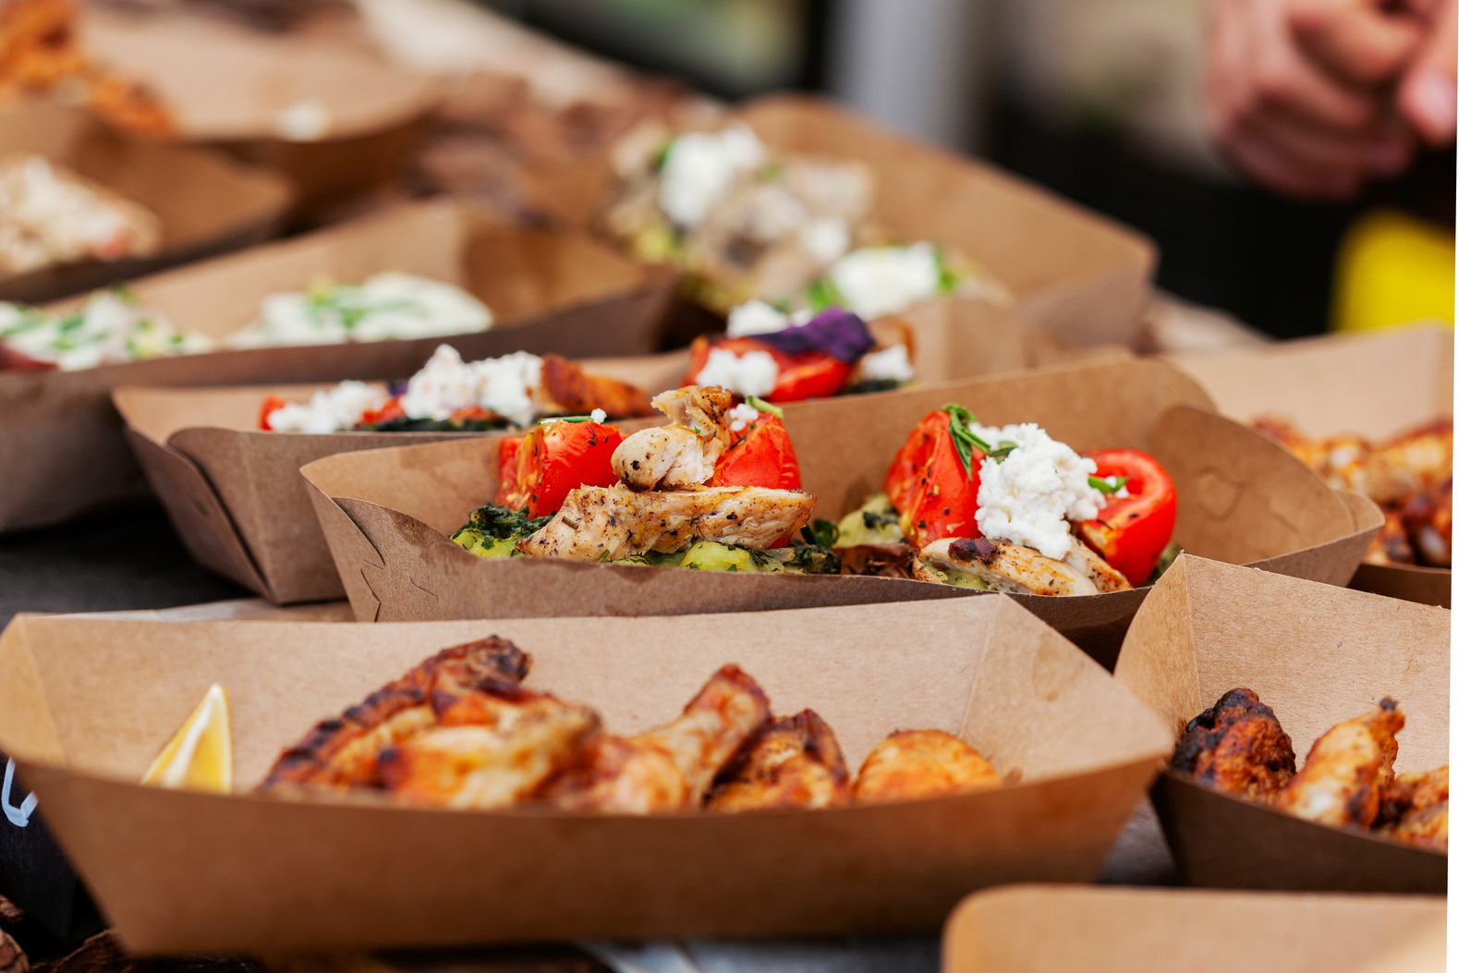


CULINARY!
Very international! You can find food from all over the world.
Traditional British foods include fish and chips, English breakfast, and tea with scones.

Slide 7

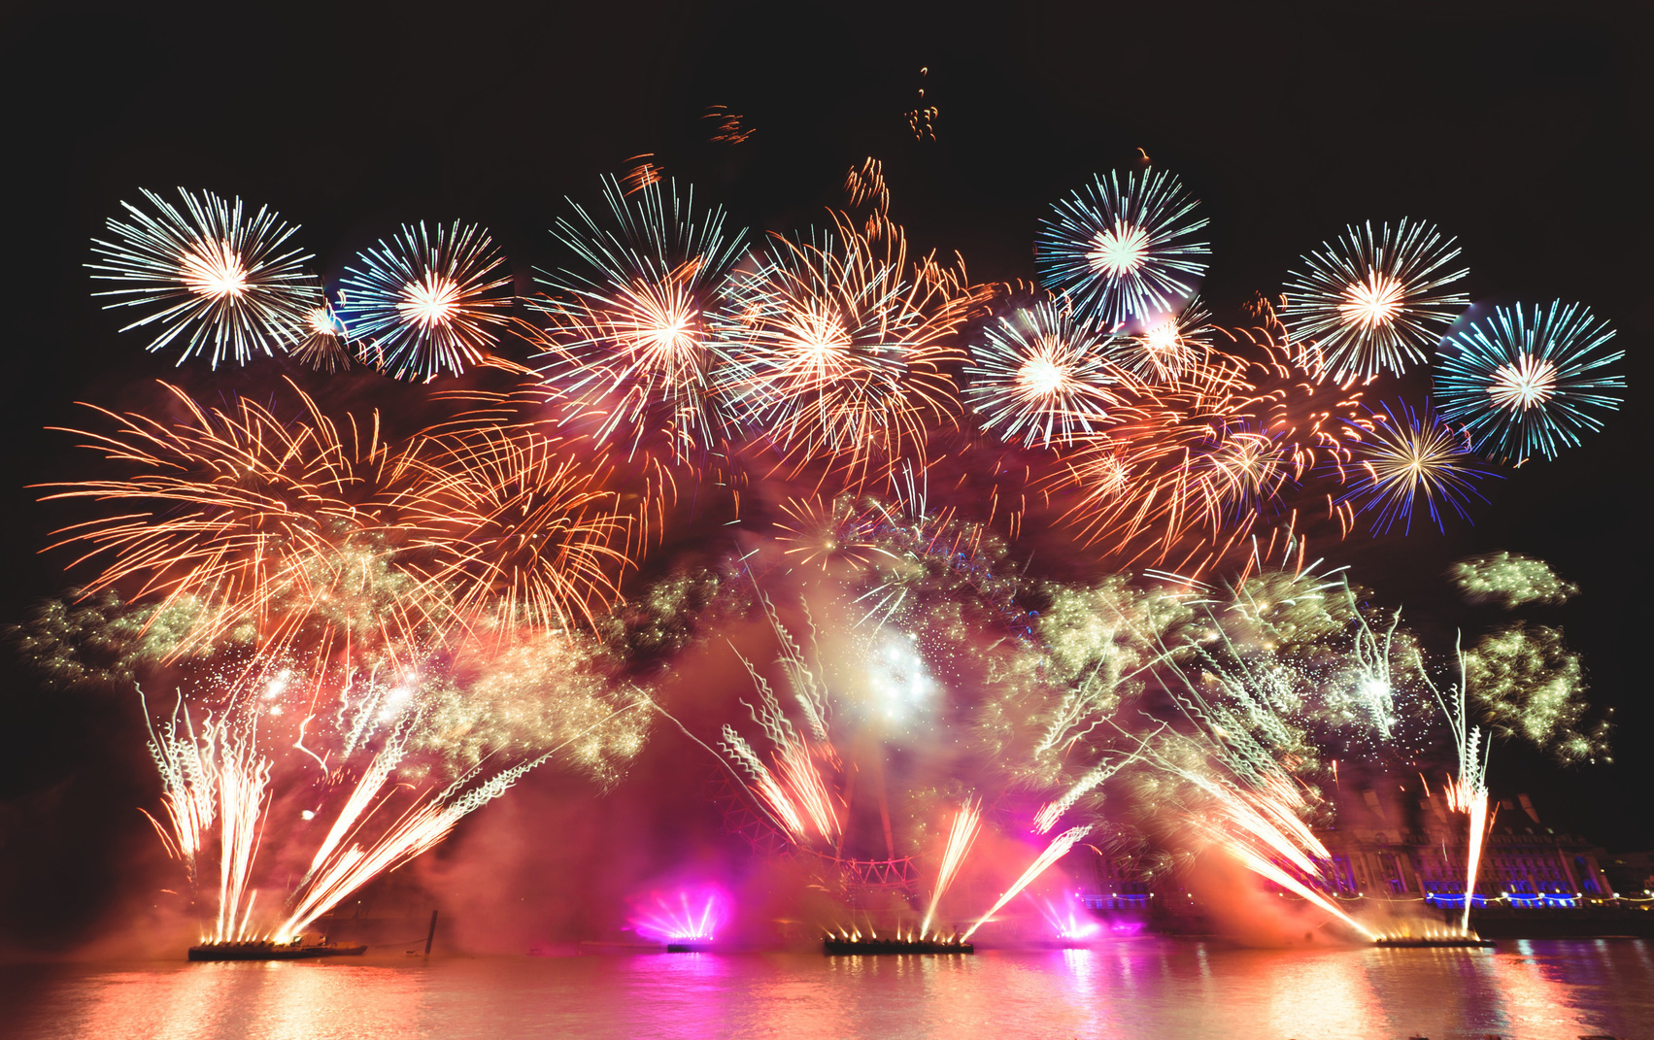

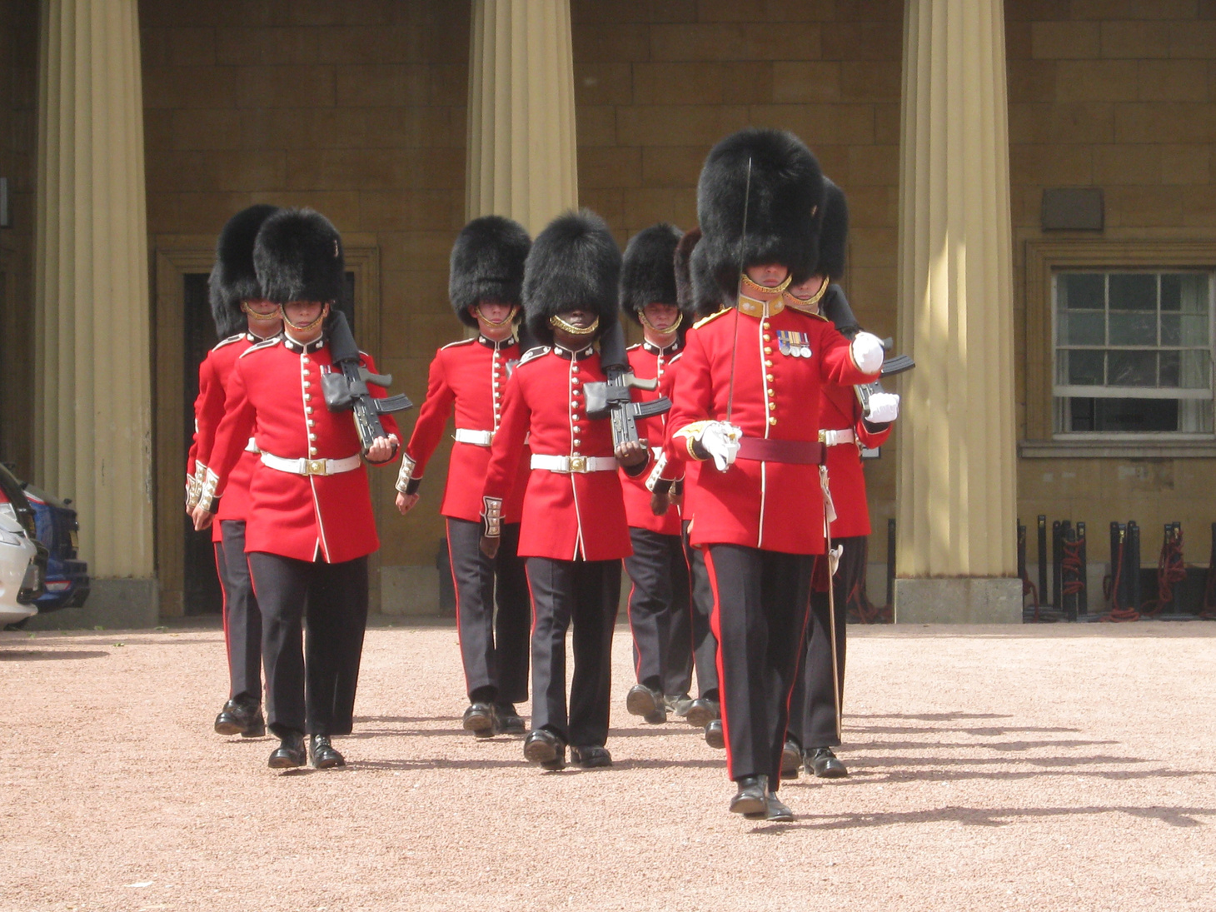
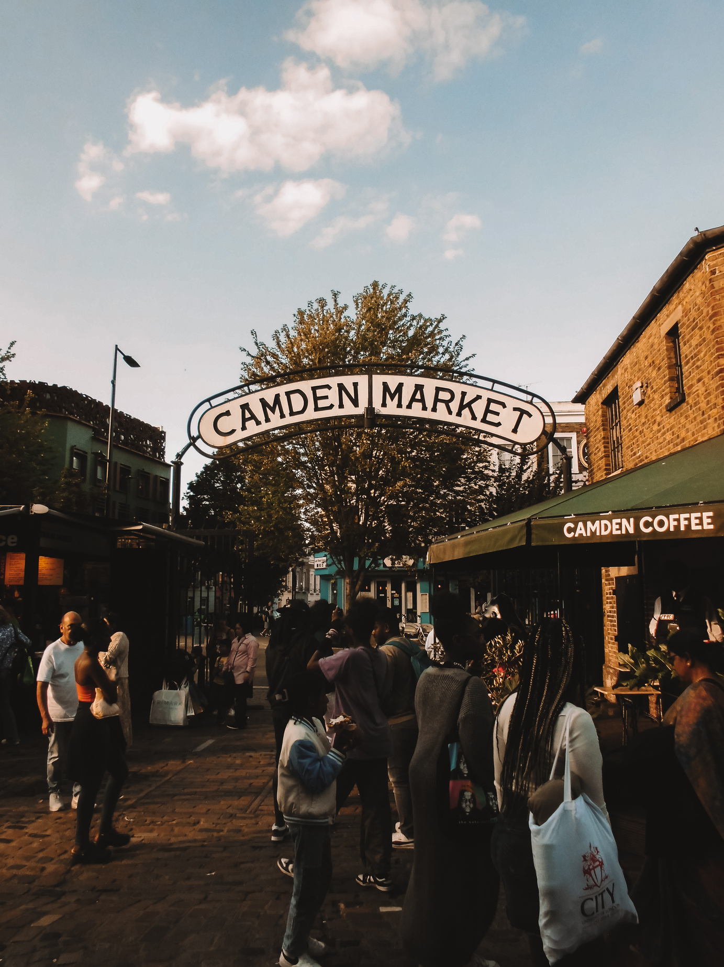
FESTIVAL
London is a major center for music, fashion, theater, and art.
Home to West End theatres, similar to Broadway in New York.
Hosts world-famous events like London Fashion Week and Notting Hill Carnival.

Slide 8
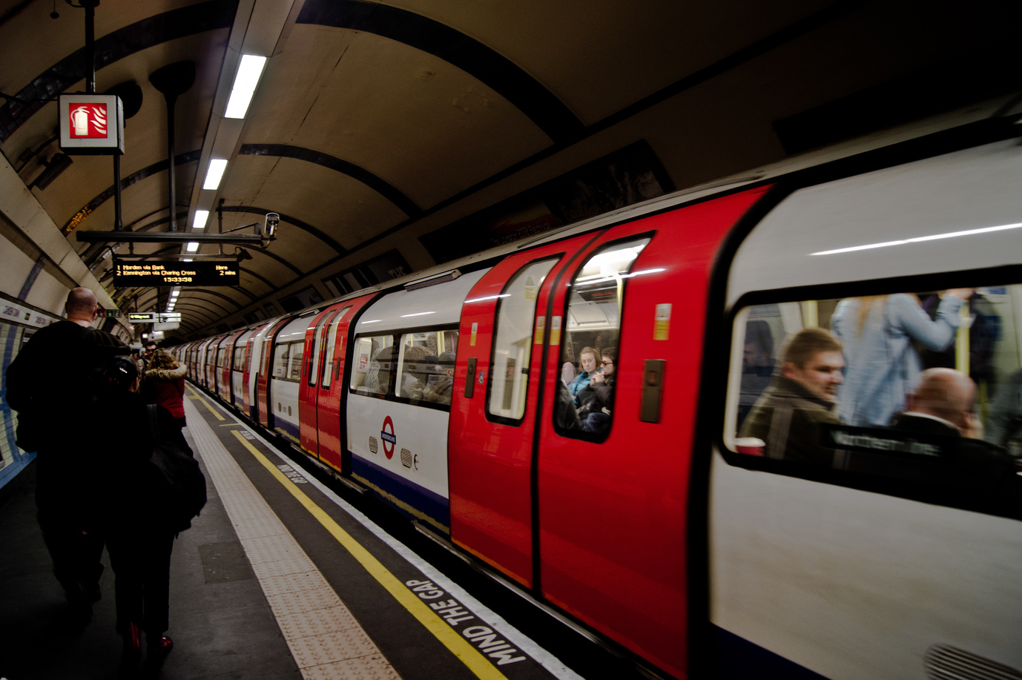
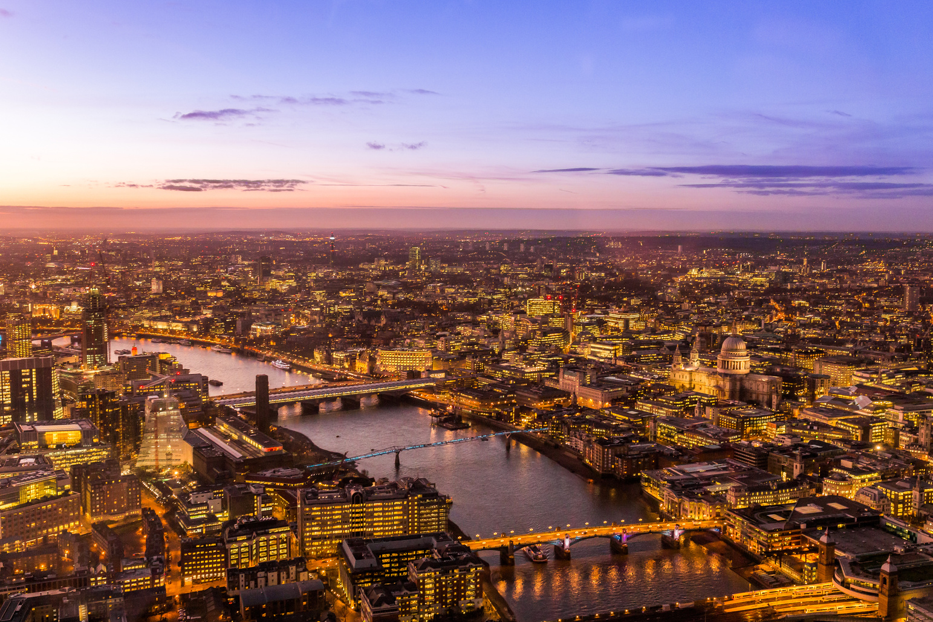
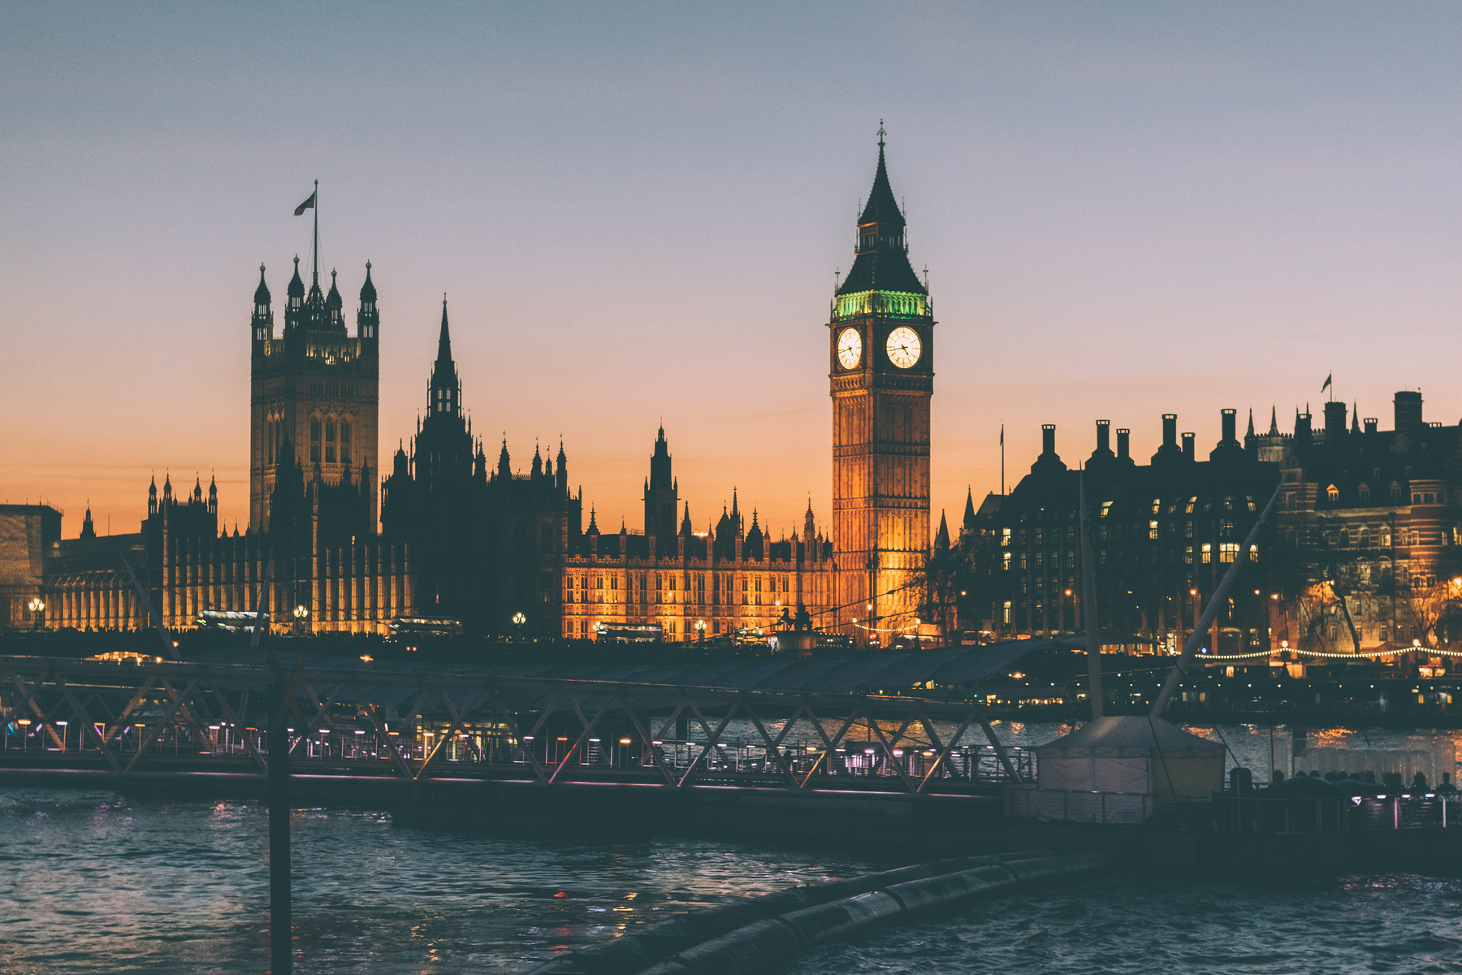
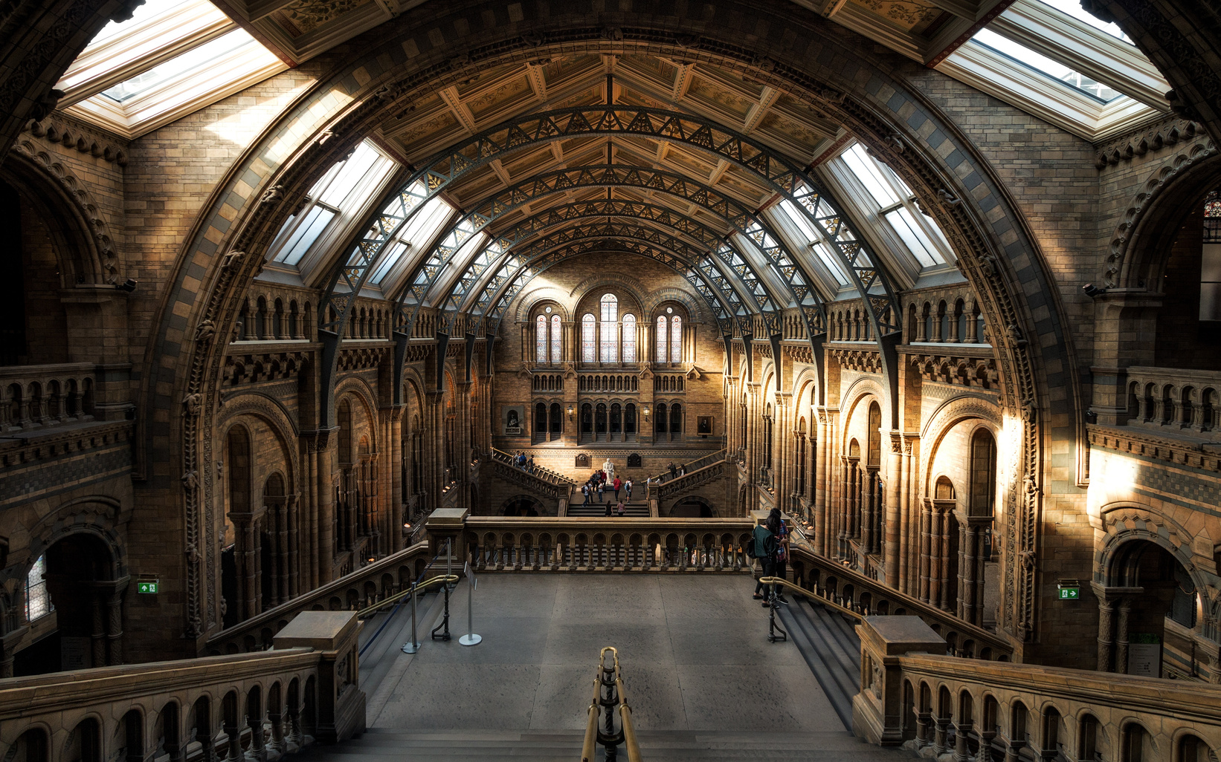
MOMENTS
TO REMEMBER

Slide 9
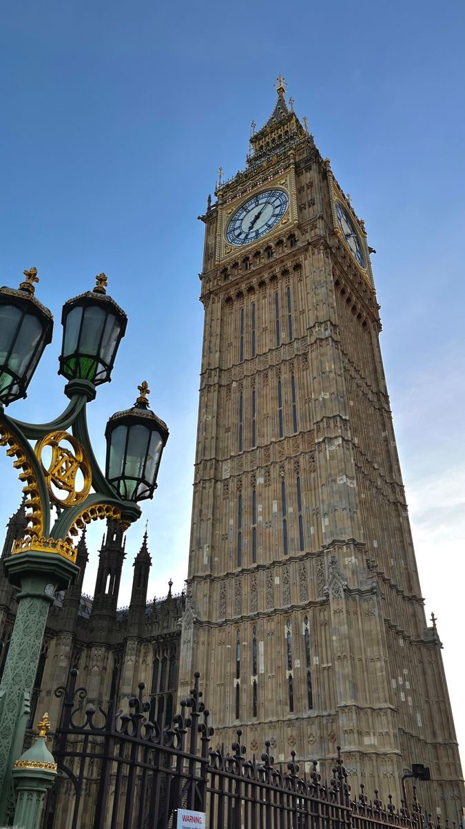
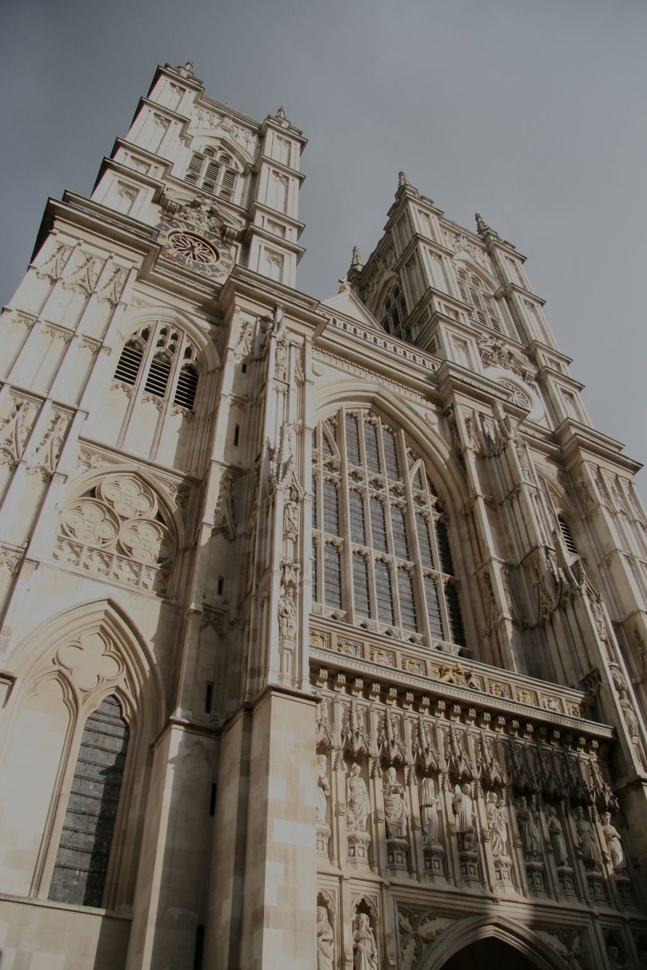
THANKS

