Slide 1
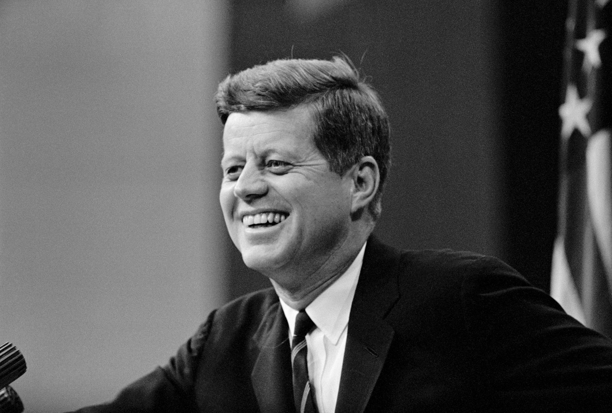
Discussion Question
1. What is the official narrative regarding JFK's assassination, and who was blamed?

Slide 2
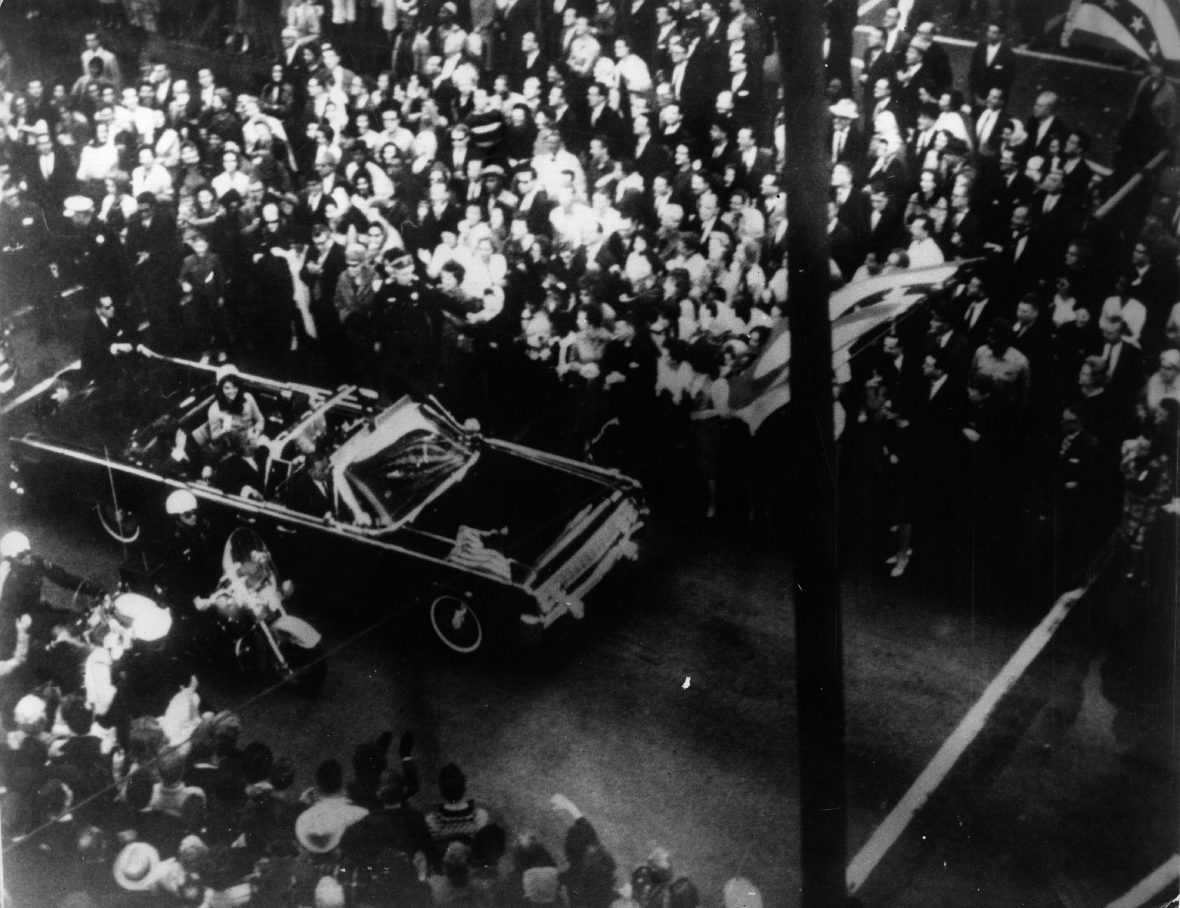
Discussion Question
2. What new developments in 2022 and 2023 reignited interest in alternative theories?

Slide 3
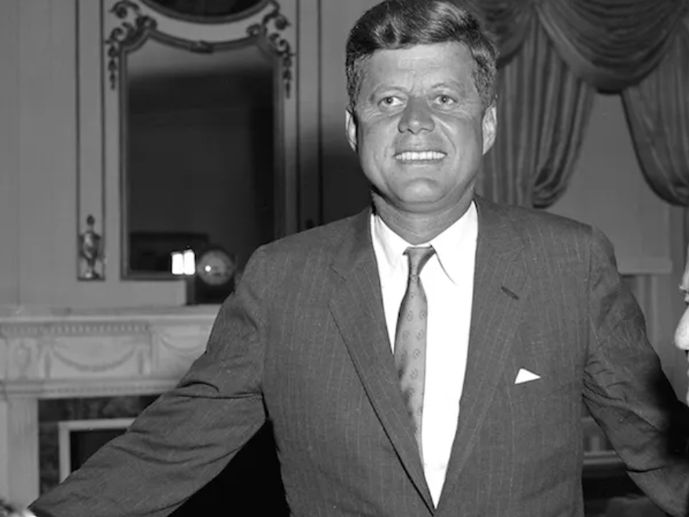
Discussion Question
3. Why was Kennedy opposed to Israel's nuclear program, and how did that create tension?

Slide 4
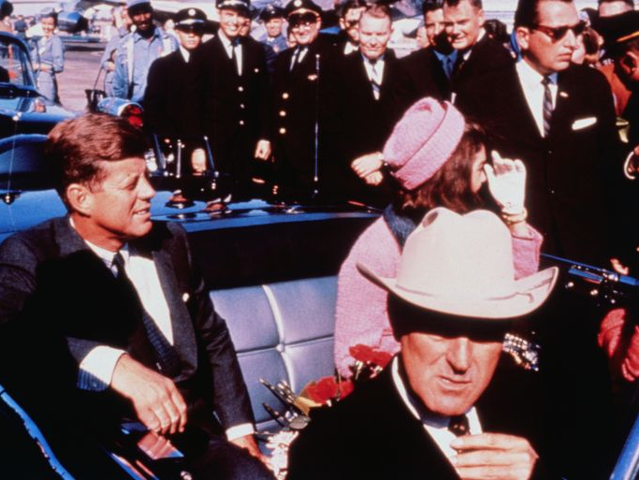
Discussion Question
4. How do proponents of the Israeli involvement theory connect JFK’s policies to a possible motive?

Slide 5

Discussion Question
5. What kind of evidence is presented to support the theory, and how reliable is it?

Slide 6
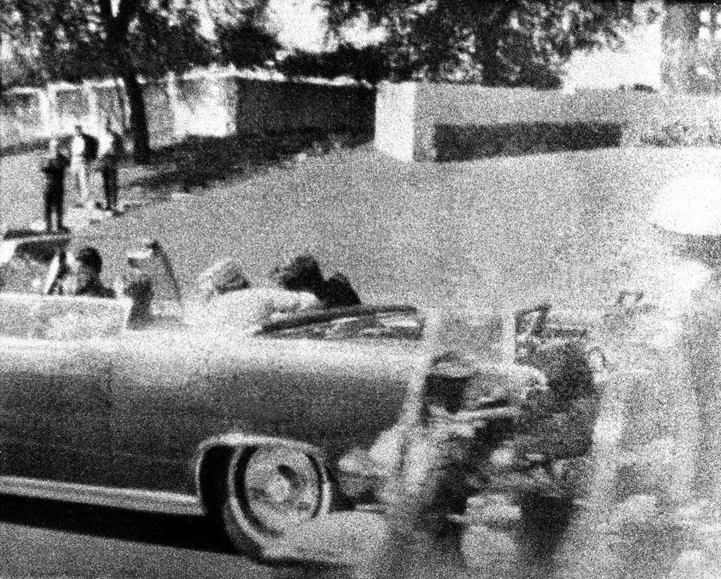
Discussion Question
6. What arguments do critics use to dismiss the theory of Israeli involvement?

Slide 7
Discussion Question
7. What did the declassified CIA memorandum mention about Oswald’s foreign contacts?

Slide 8
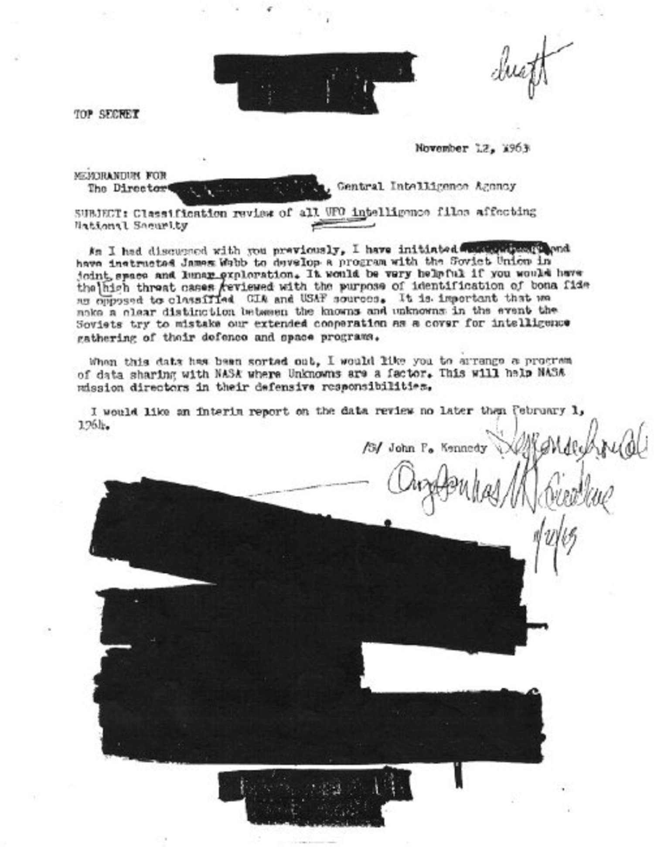
Discussion Question
8. How do historical contexts like the Cold War and JFK’s civil rights stance affect interpretations of his assassination?

Slide 9
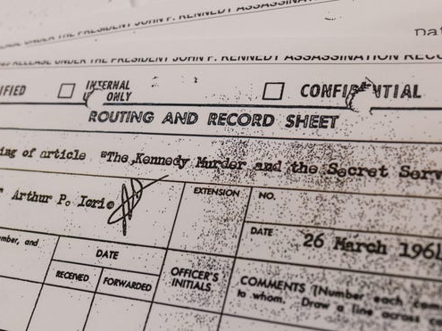
Discussion Question
9. What challenges arise when investigating events with classified or redacted information?

Slide 10
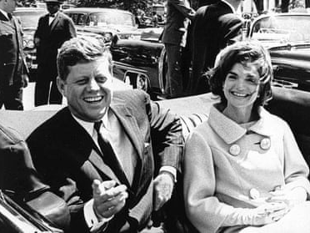
Discussion Question
10. How can we evaluate controversial theories responsibly without promoting misinformation?

