Slide 1
My presentaton potos

Slide 2
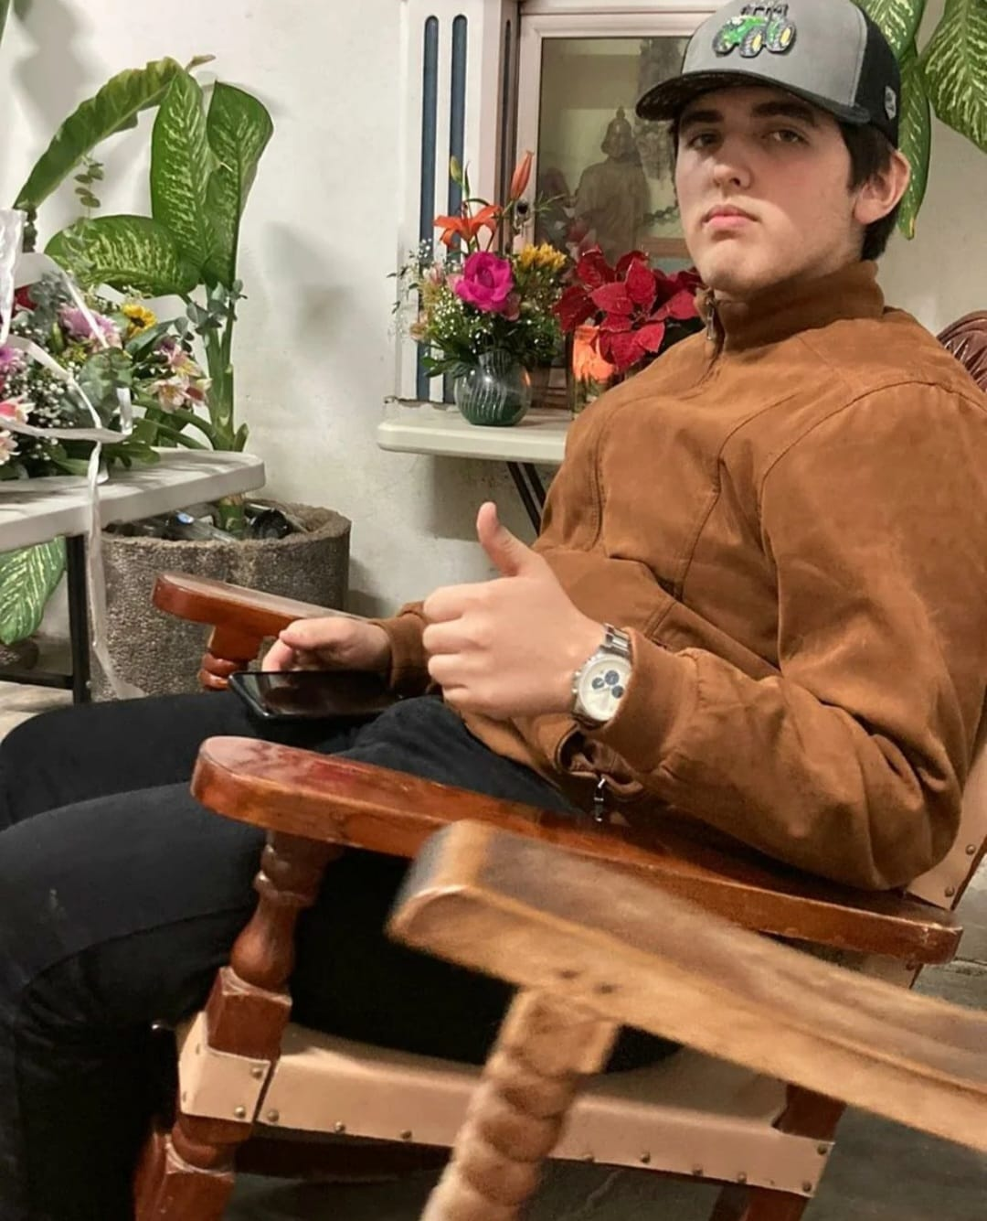
In this photo he was very alucinated because he was at very belikas parties.

Slide 3
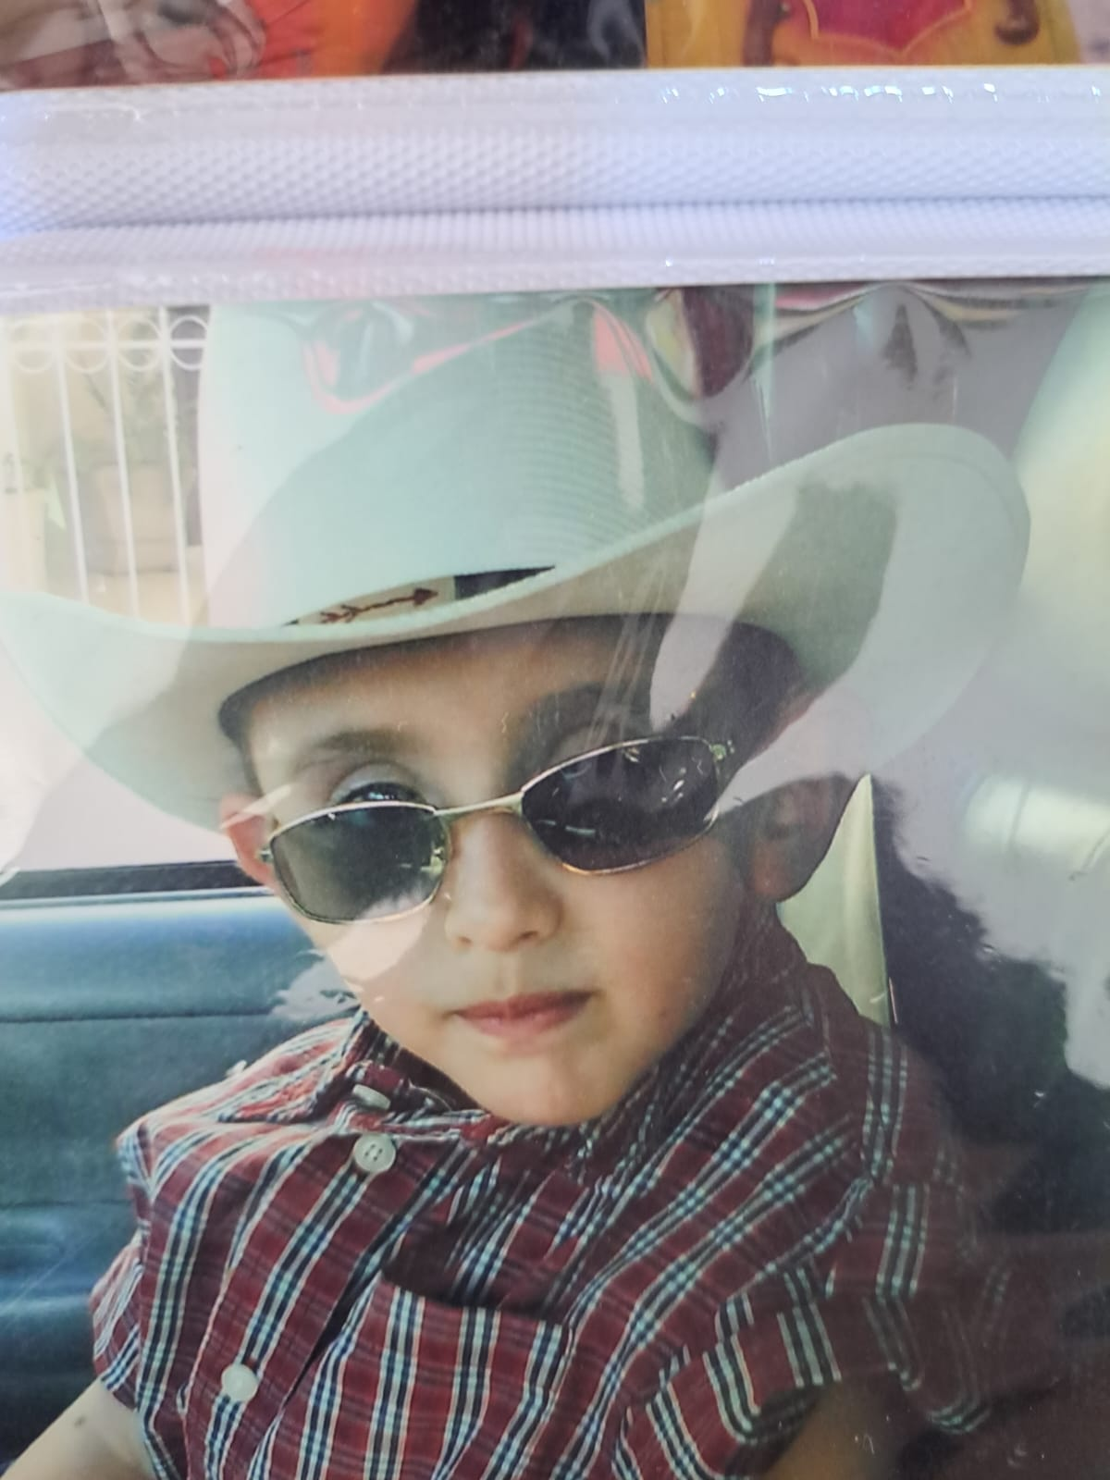
In this photo he was very placoso because he was just going to check the cattle.

Slide 4
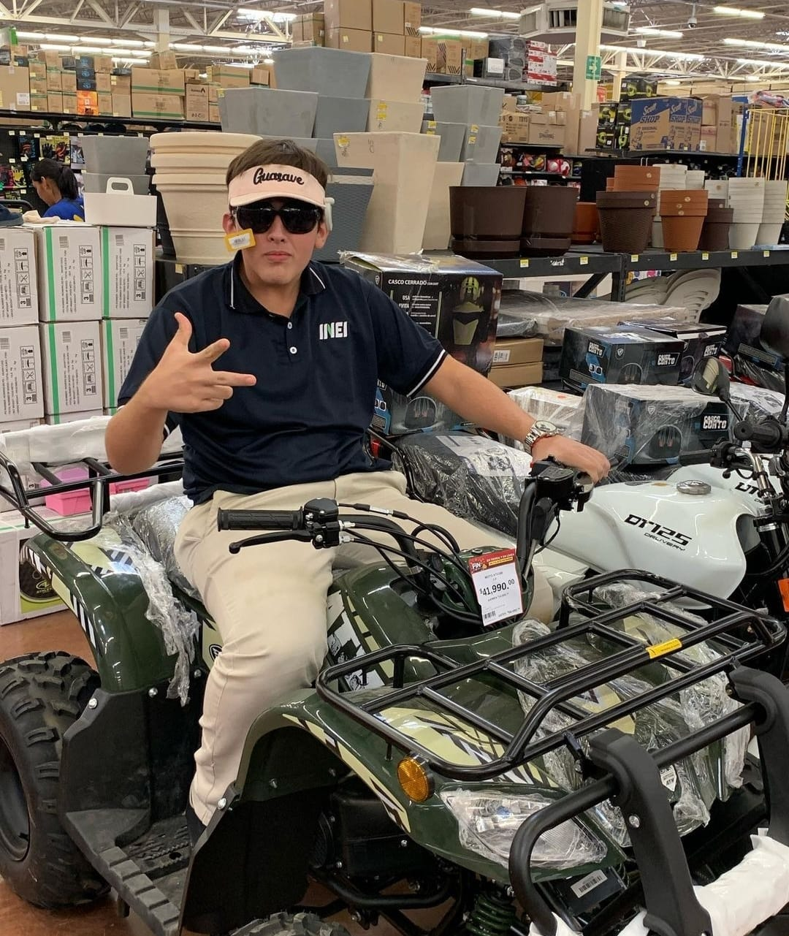
In this photo I was preparing for Semana Santa

