Slide 1
English presentation
Carolina Rubio

Slide 2
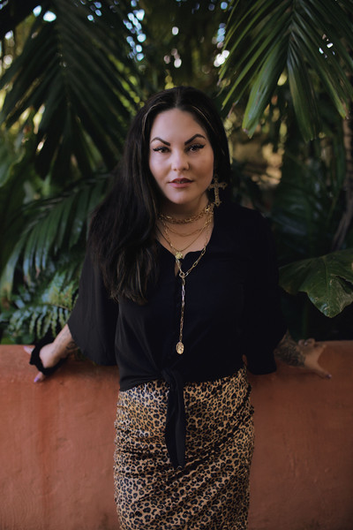
ScarletT ST. CLAIR
This saga of books are from the Author Scarlett St. Clair; she was born in the Muscogee Nation. She is also the author of the King Of Battle & Blood saga and When Stars Come Out. She has a master's degree in Library Science and a degree in Creative Writing.

Slide 3




This is a series called of Hades X Persephone it´s conformed mainly by... it tells the story of why seasons the year exist in the normal world also why winter exists in our world... well, obviously it's about from Greek mythology, this originates from the love story of Hades and Persephone... This saga of 7 books; tells us their most detailed story of how they met, how they fell in love and… all those things; But at the same time it's not a cliche story, it's a love story different, that's why I liked it.

Slide 4



These are the other books…It is very entertaining because it is based on the ancient city of Athens, but at the same time, there are cell phones, there are clubs, universities, restaurants, clothing stores, cars, etc.
The truth is that I highly recommend them if you like Greek mythology, if you want to learn Greek mythology or if you simply want to entertain yourself with a very good book, highly recommended.

