Slide 1
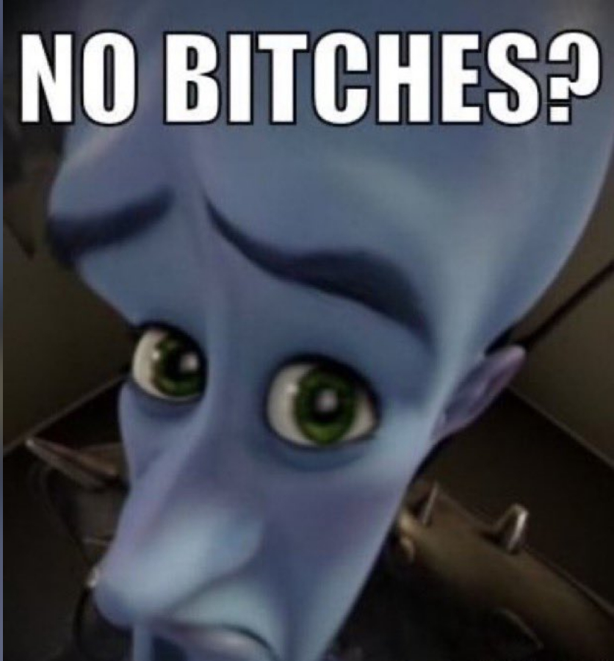
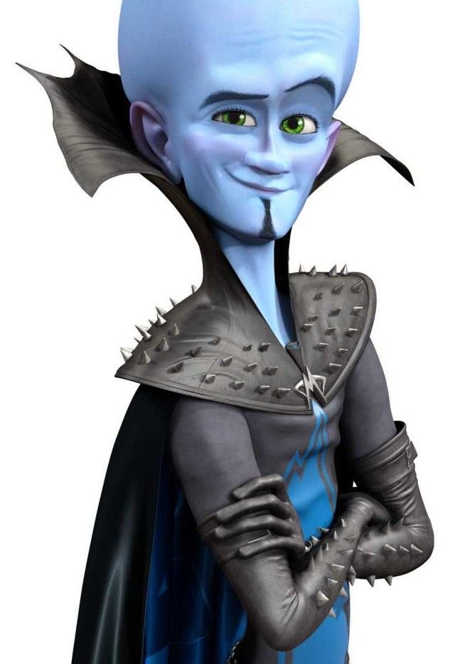
MEGAMIND
Hannah Citlallitl Pájaro Villegas

Slide 2

What about the production?
-Produced in october 30 of 2010
-Director: Tom McGrath
-It had a recaudation of 321 million USD

Slide 3






What is the movie about?
Esta foto de Autor desconocido está bajo licencia CC BY-SA

Slide 4
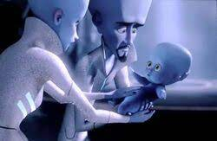

Slide 5
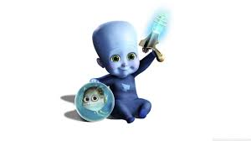
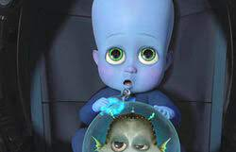

Slide 6
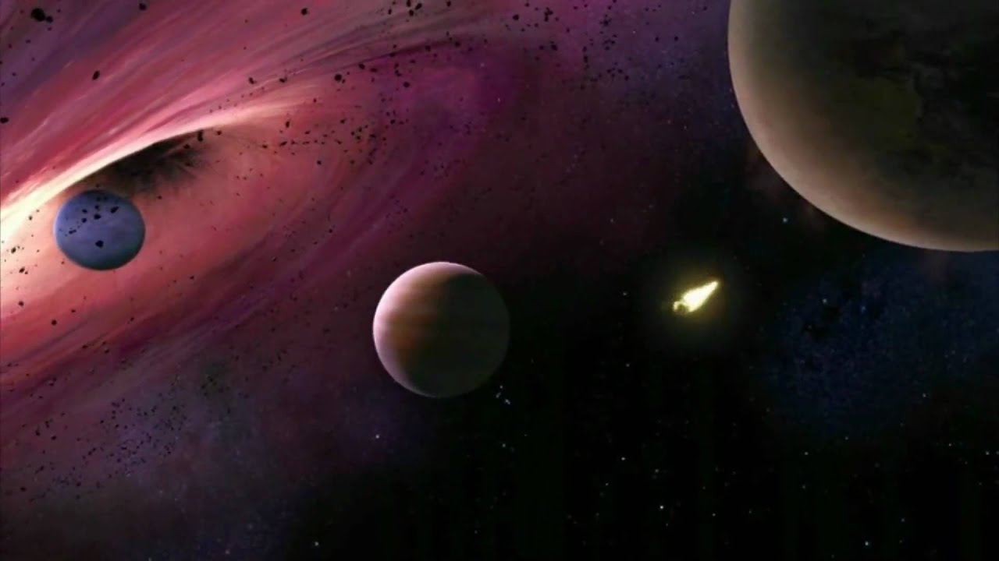

Slide 7
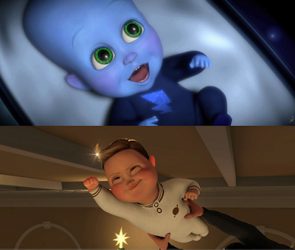

Slide 8
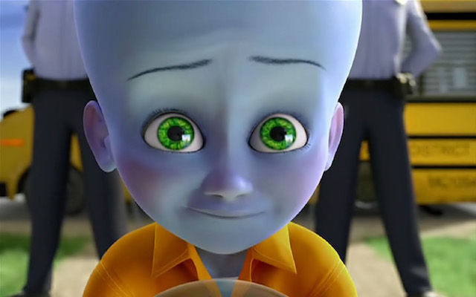

Slide 9
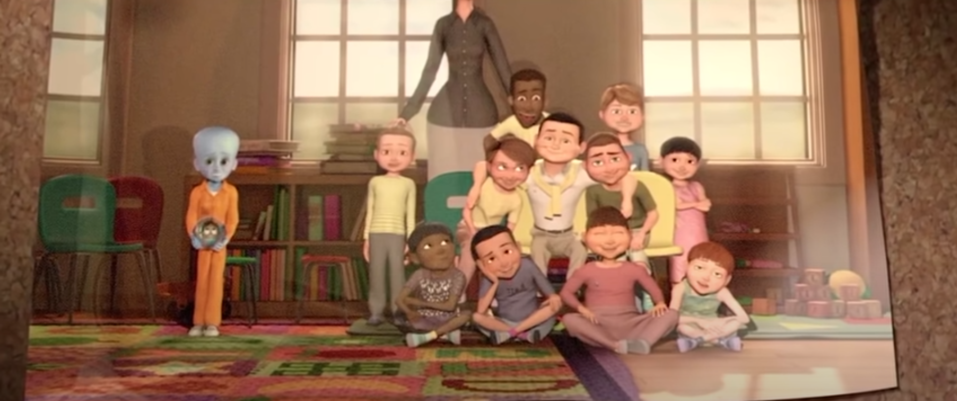

Slide 10
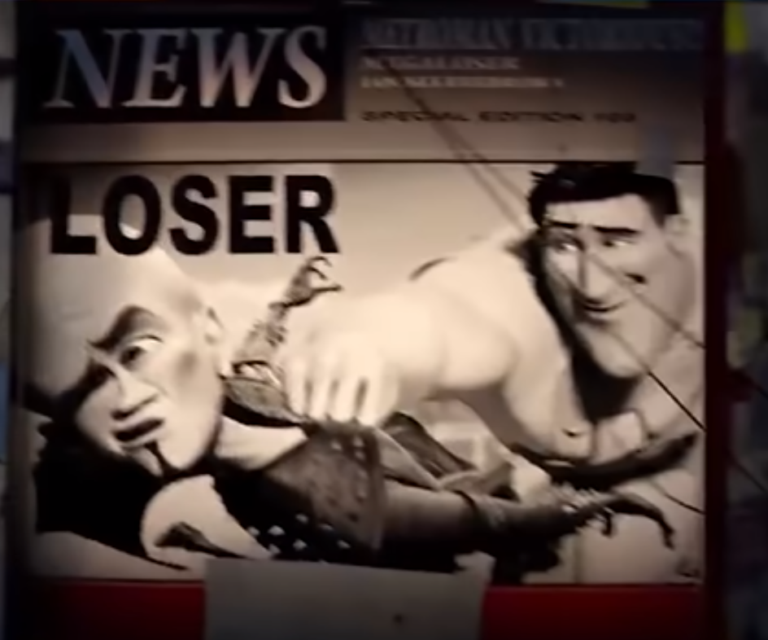

Slide 11
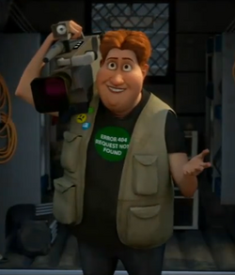

Slide 12


Slide 13
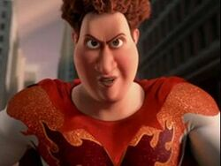

Slide 14


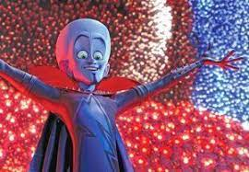
valoration
-puntuation 10/10
-good animation
-good soundtrack
-the best scene in animation

Slide 15



Thank you!!

