Slide 1
soccer
Antonio Edu Ibarra Acosta

Slide 2

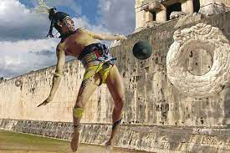
where was it created?
2,000 years ago to ancient China. Greece, Rome, and parts of Central America also claim to have started the sport; but it was England that transitioned soccer, or what the British and many other people around the world call “football,” into the game we know today.

Slide 3
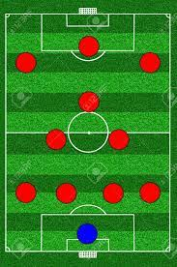
What is it?
soccer consists of 11 men spread out on a field, the technical director is the one who decides how to accommodate them depending on the game that is expected

Slide 4
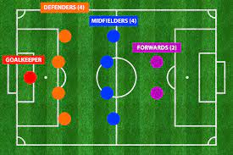
positions
In soccer there are 4 main positions: goalkeeper, defender, midfielder and forward.

Slide 5
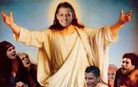


the best soccer team
The best soccer team arround the world is LAS PODEROSISIMAS CHIVAS RAYADAS DEL GUADALAJARA

Slide 6

thanks for your attention

