Slide 1
poverty
Paola,Barush,Arantza,Maria,Guillermo,Bryan

Slide 2
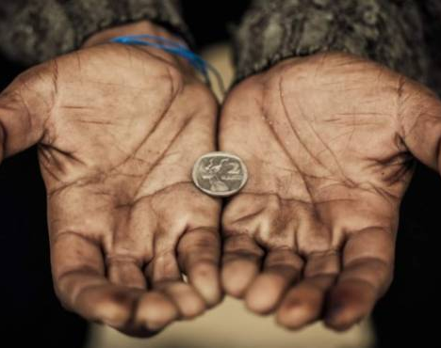
what is poverty?
Poverty is a situation in which it is not possible to satisfy the basic physical and psychological needs of a person, due to lack of resources such as food, housing, education, health care, drinking water or electricity.

Slide 3
solutions
help people
Better social protection can help the poor better manage risks, strengthen their livelihoods, and improve the education and health of their children. Therefore, it will not only help accelerate the eradication of poverty and hunger, but also reduce disparities in life opportunities, as well as help from the government and society.

