Slide 1
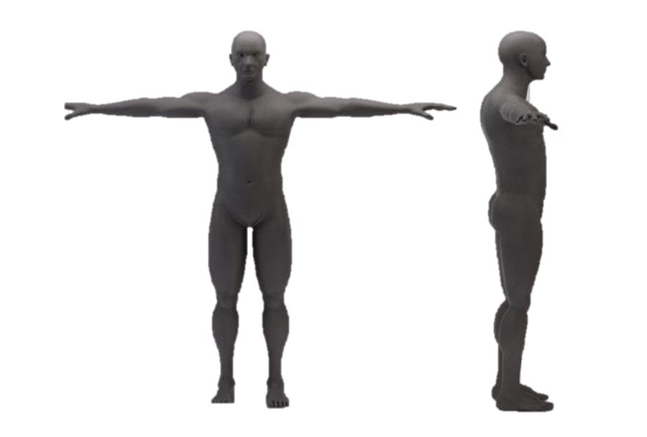
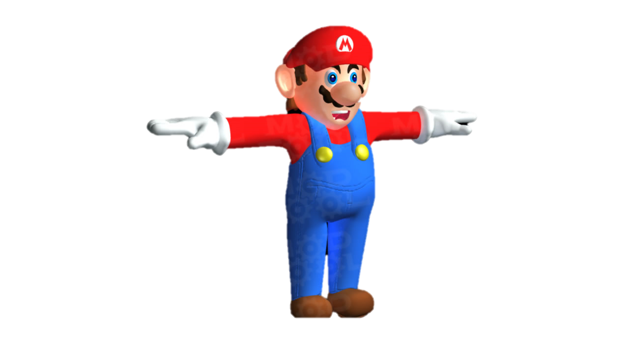
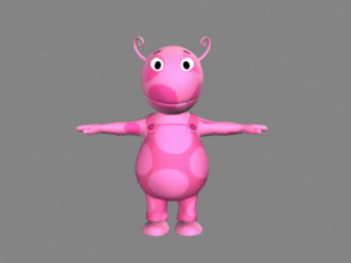
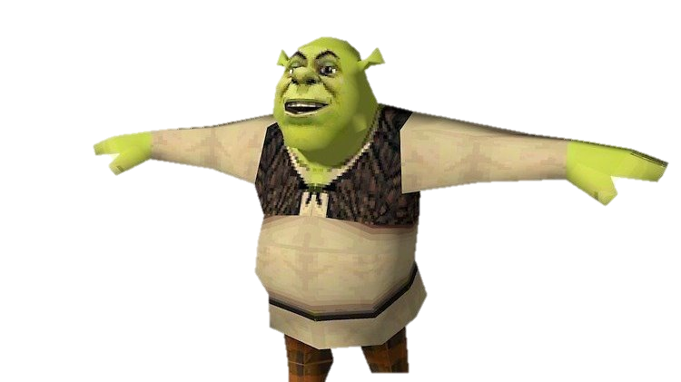
T-POSE
BY WALDO, EDU Y JORGE

Slide 2


When was this trend born?
It began in 2010 but spread in 2016 as a so-called deep-fried memes,

Slide 3

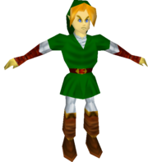
Also called a reference pose, is used in the 3D animation and video game industry. For ease of coding and editing.

Slide 4
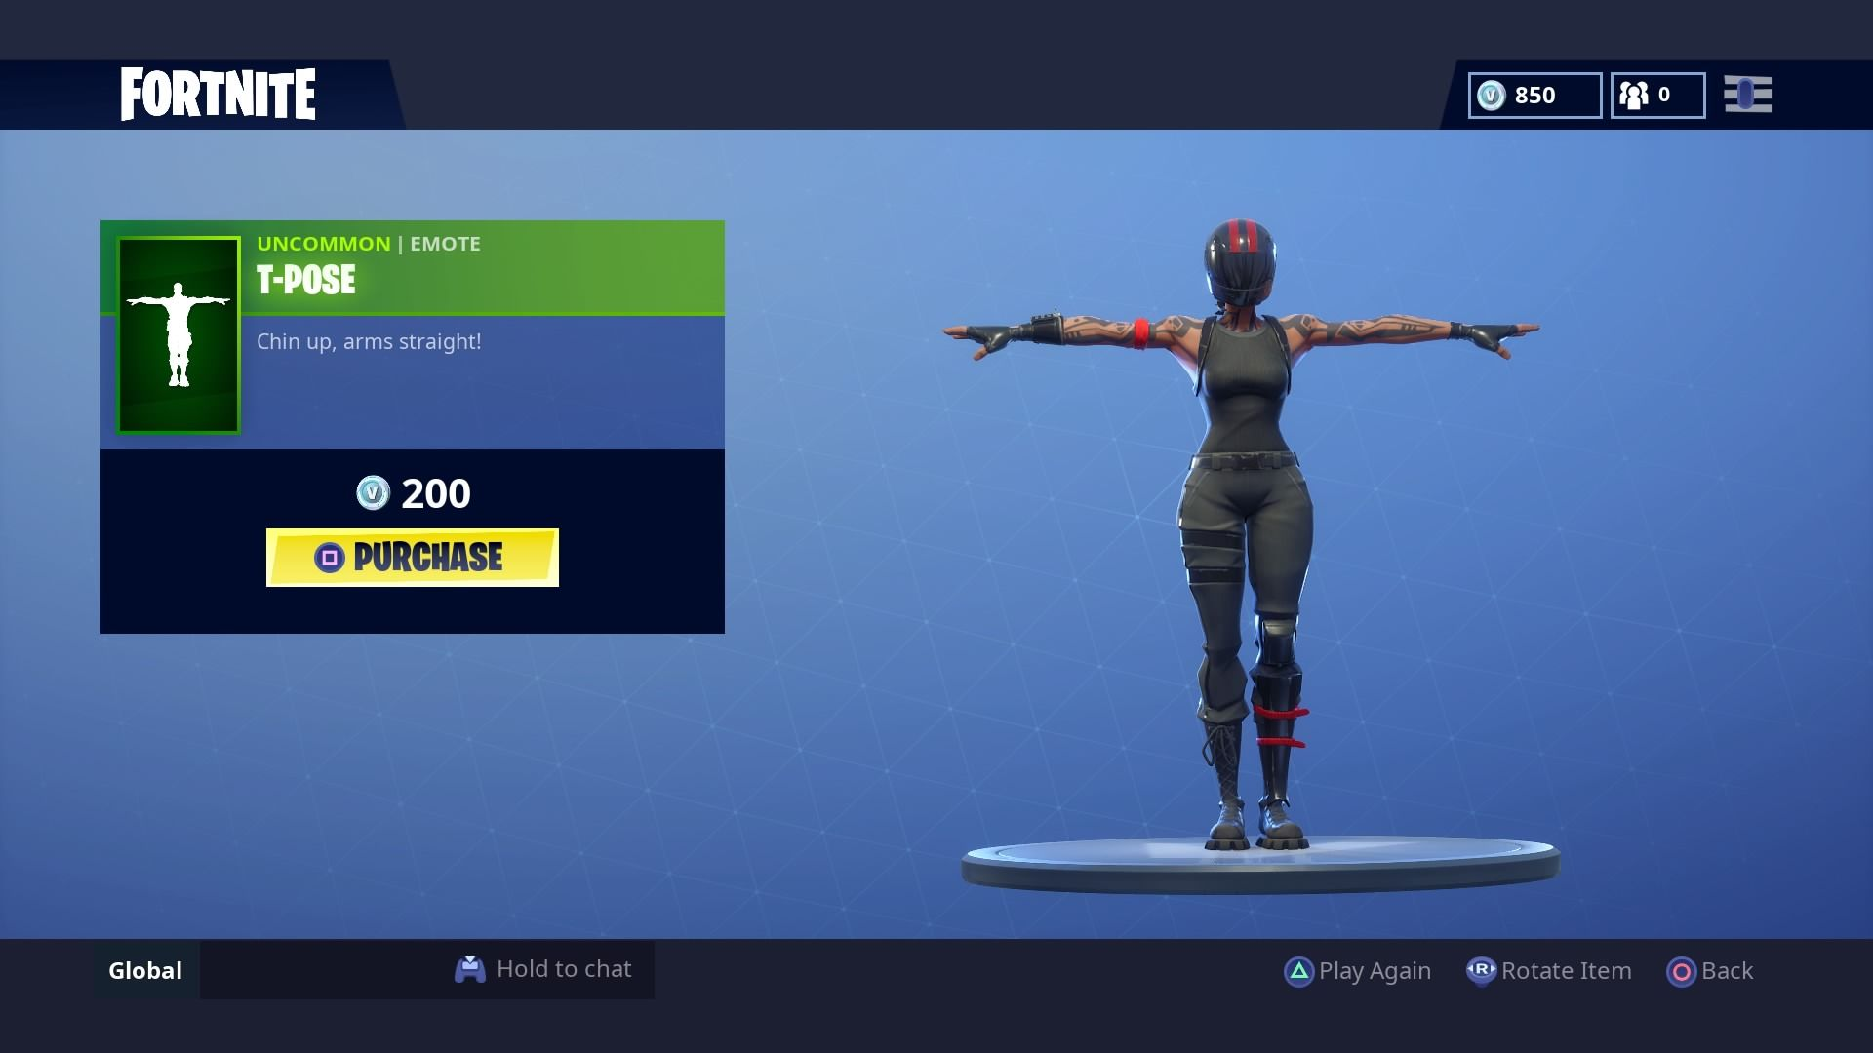

Slide 5
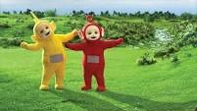
Another reason for the popularity of this trend is the bugs in video games, because sometimes the t-pose appears due to bugs in games, making people who saw it laugh.

Slide 6
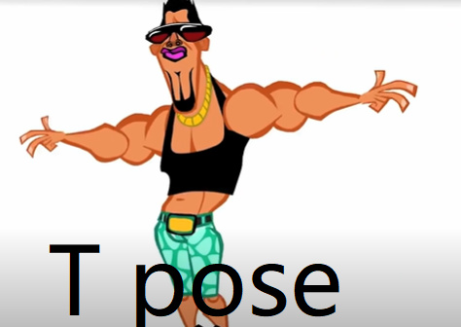
TANKS! :)

