Slide 1
THE FLOOR IS LAVA
XIMENA, YAMILE AND SEBASTIAN

Slide 2
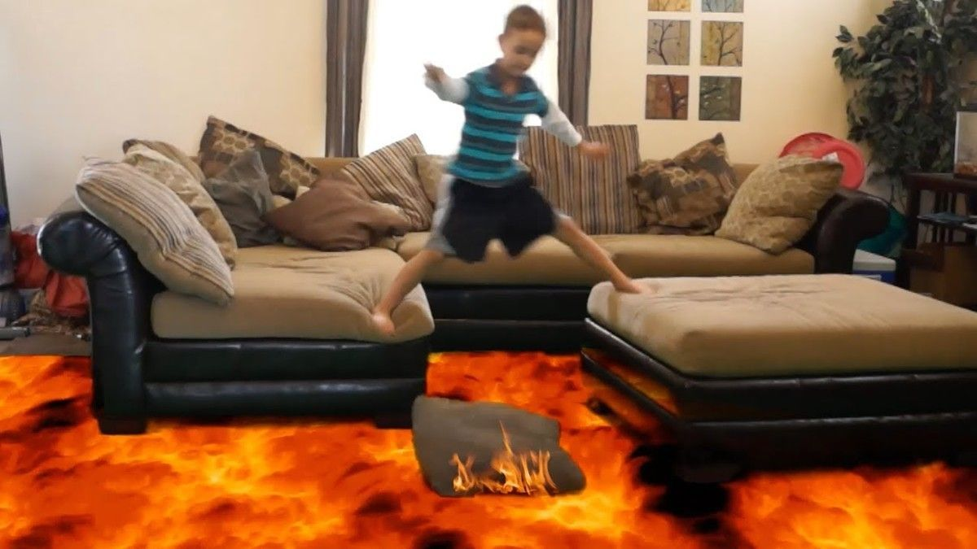
WHAT IS IT?
The floor is lava is a game in which players pretend that the floor or ground is made of lava, and thus must avoid touching the ground, as touching the ground would kill the player who did so. The players stay off the floor by standing on furniture or the room's.

Slide 3
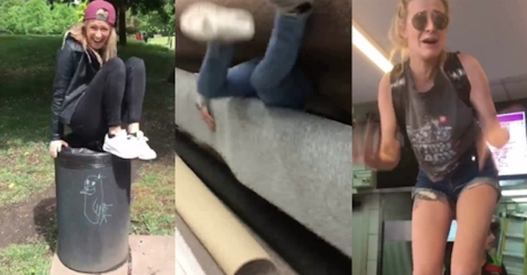
WHEN WAS THIS TREND CREATED?
The floor is lava became famous in 2016.

Slide 4

WHAT IS THIS TREND INSPIRED ON?
This challenge is based on a game created by Roald Dahl where a child imagined that the floor was lava, this game was created in 1948.

Slide 5
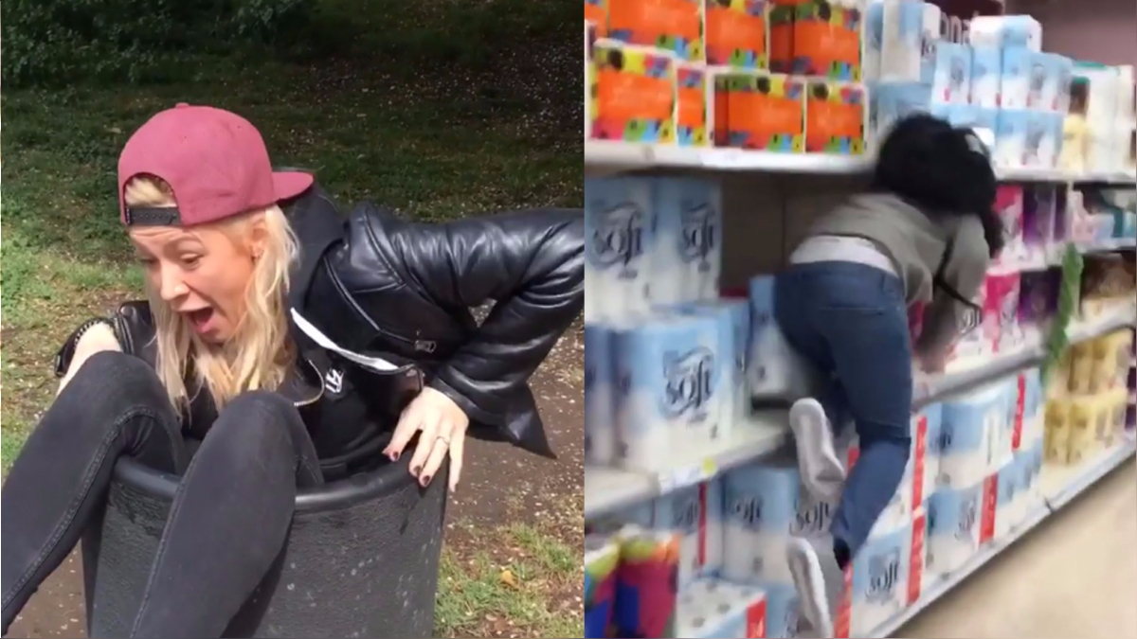
HOW DID BECOME FAMOUS THE FLOOR IS LAVA?
The phrase the floor is lava was mentioned in the Simpsons but the game went viral thanks to some instagrammers who uploaded a viral video making the challenge.

